Slide 1
Healthy Cypriot foods
Andreas Phasarias
G1 class

Slide 2
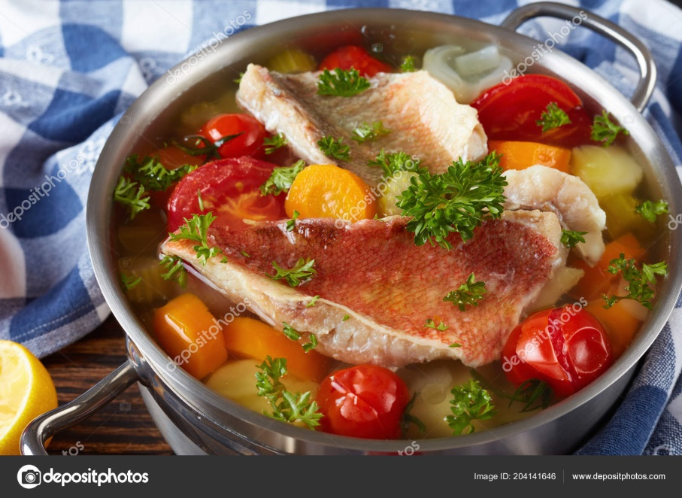
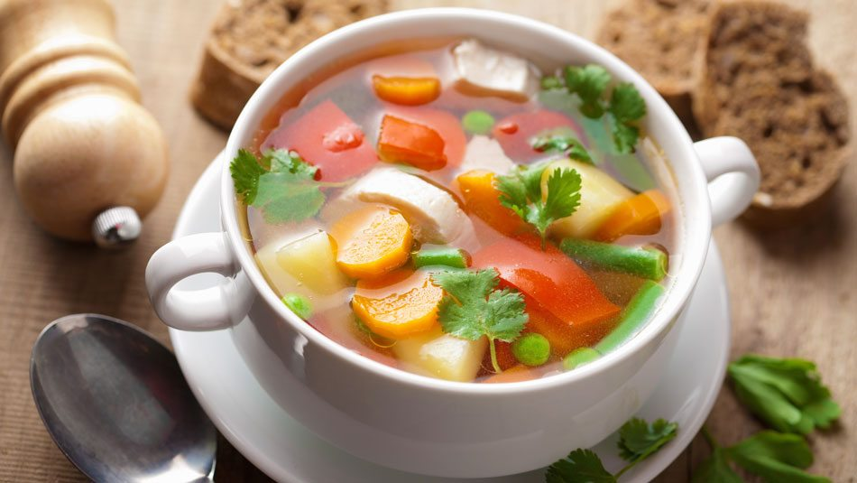
Soups
Fish soup
Made with various fish and vegetables
Vegetable soup
Made with various vegetables and optional beef

Slide 3
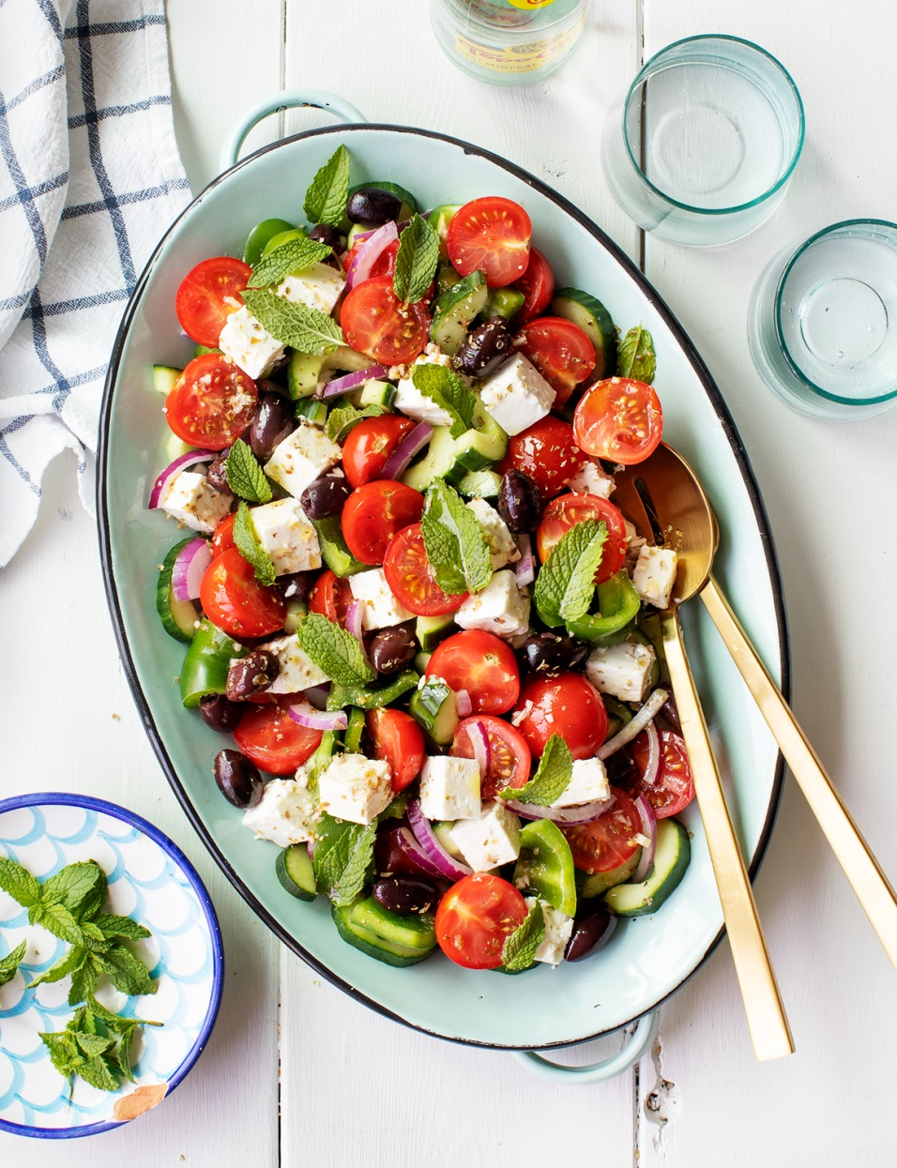
Salads
Village salad
Made with seasonal vegetables and fetta cheese

Slide 4
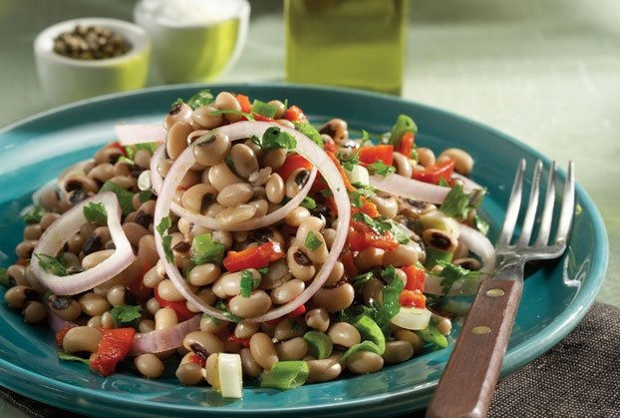
Black-eyed beans salad Made with boiled black-eyed beans, tomato, onions, lemon and olive oil with optional tuna

Slide 5
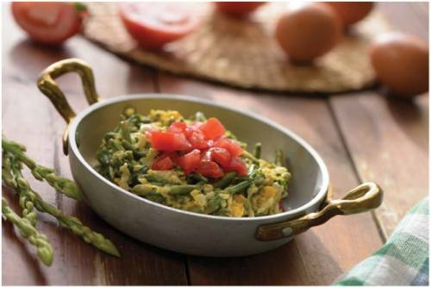
Vegetable based dishes
Wild asparagus
Fried or boiled with lemon and with scrambled eggs

Slide 6
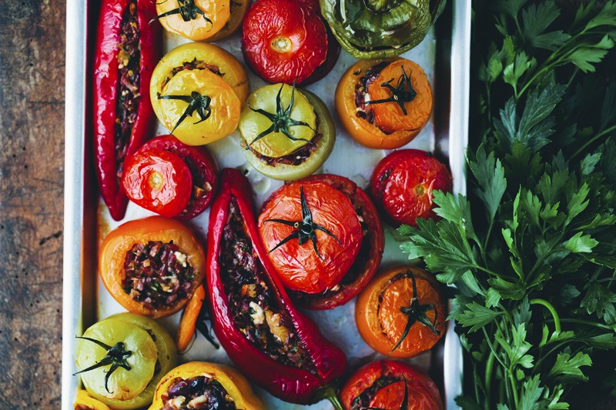
Stuffed vegetables
Is stuffed with rice and minced meat and the ideal vegetables for stuffing are peppers, tomato and eggplants

Slide 7
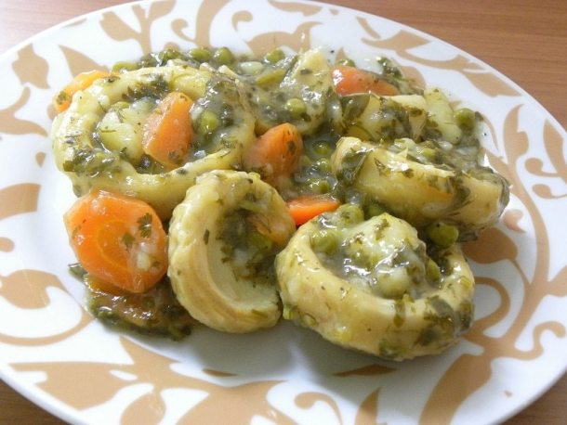
Artichokes
Made with lemon sauce and potatoes and optional carrots

Slide 8
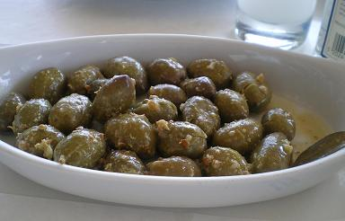
Coriander crushed olives
Made with garlic and lemon

Slide 9
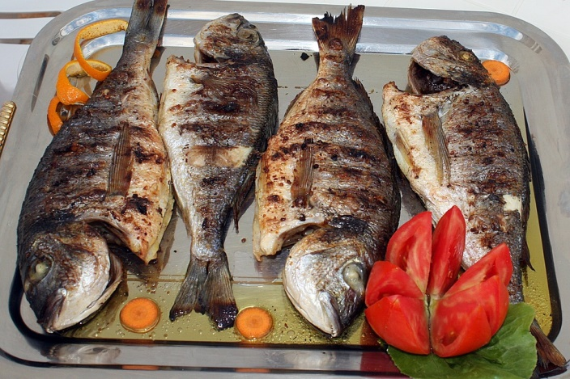
Seafood
Various barbequed fish
Made with olives, lemon and garlic sauce

Slide 10
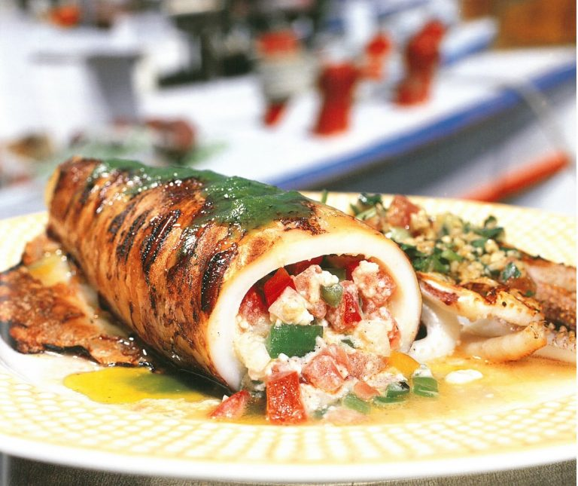
Stuffed kalamari
Either stuffed with rice or fetta and tomato

