Slide 1
EATING HABITS IN YKB ( Kayseri - TURKEY)
A Questionnaire

Slide 2
General Information
There are 20 questions and mostly based on Slovakian Team’s Work.
328 participants joined it. ( 128 boys and 200 girls )
We suggested that their parents also involved it.

Slide 3
Grades | Boys | Girls
5th Grades | 32 | 38
6th Grades | 33 | 53
7th Grades | 30 | 48
8th Grades | 33 | 61

Slide 4
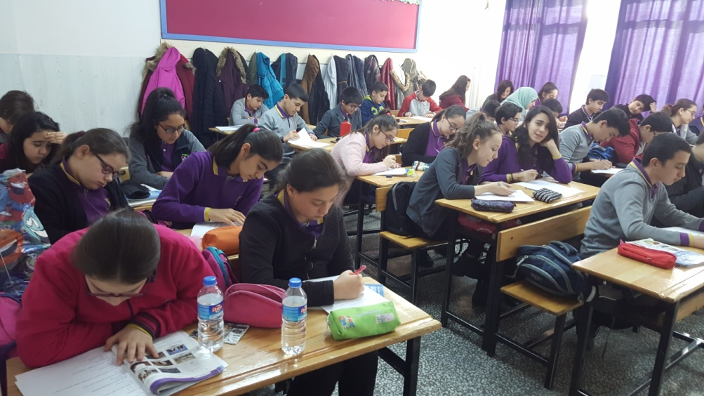
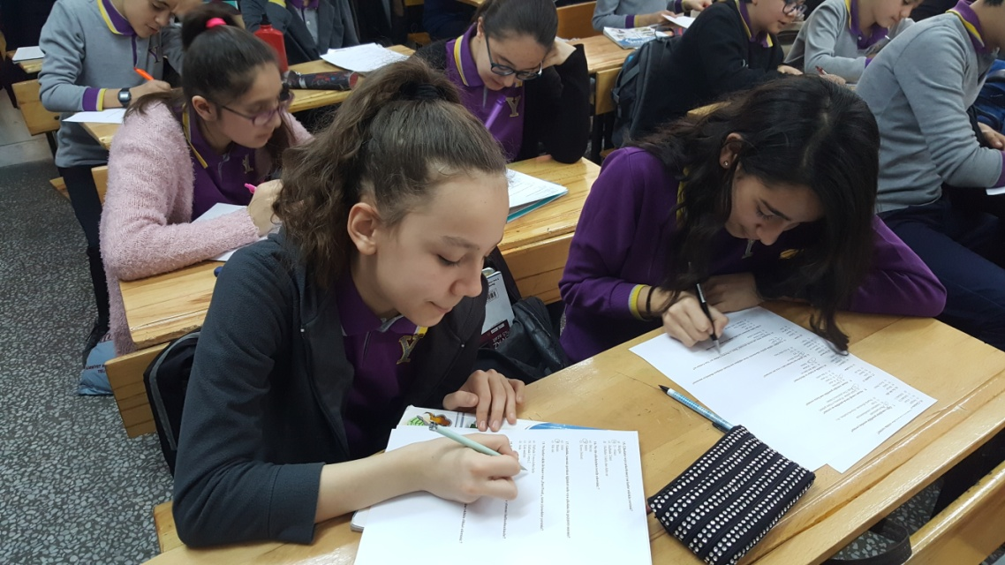
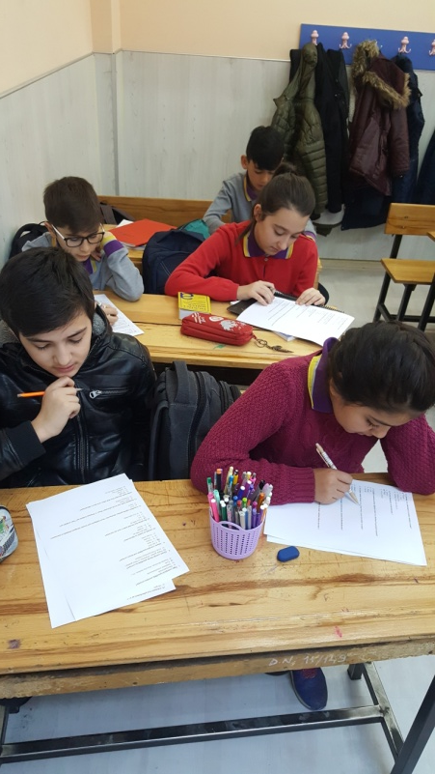
Here are some photos while the students were doing the questionnaire

Slide 5
some highlights from the questionnaire
%86 students eat meals 2 or 3 times in a day
%73 students think that breakfast is the most important meal of the day
Only % 6 students are vegetarian

Slide 6
A little more from half of the students stay at home and have lunch at school canteen with % 53 .
Nearly all of them prefer hot and cooked dinner and eat between 6 and 7 p.m.
More than half of the students eat vegetables of fruit everyday.

Slide 7
Their parents mostly prefer BOILING when they cook.
They avoid from Fast Food
They like sweets and chocolate everyday.

Slide 8
Deep Thanks for listening to us…

