Slide 1
Food Ethos EDucation in Schools" “FEEDS” 2018-2020
5th Meeting
Student Workshop
VERGINA GYMNASIUM
Larnaca, Cyprus

Slide 2
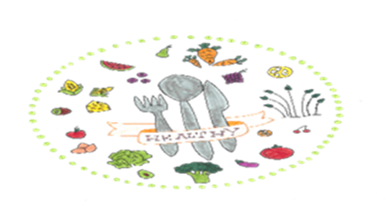
15 General Knowledge Questions on Nutrition ... Can you answer them?
Name the nutrients in foods.
Proteins
Carbohydrates
Lipids
Nucleic acids
Vitamins

Slide 3
2.What do the nutrients in the food offer to the human body?
They provide energy
For body development
For replacement of dead cell
For wound Healing
3.Which nutrient has more calories?
Lipids give 9 Kcal /gr while proteins and carbohydrates give 4 Kcal /gr.

Slide 4
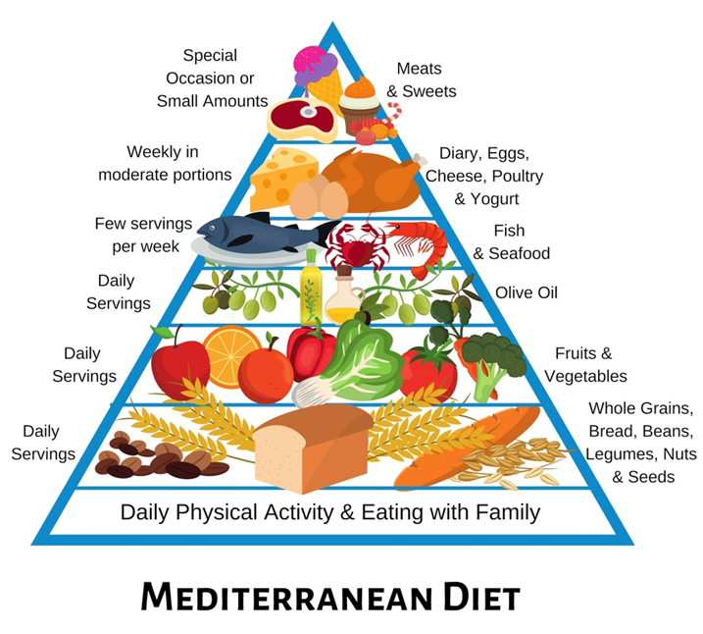

Slide 5
4.Based on the Mediterranean pyramid write four foods that we should consume every day.
Bread
Fruits
Vegetables
Nuts
5.Based on the Mediterranean pyramid write four foods that we should consume a few times a week.
Fish •Eggs •Cheese
•poultry •Yogurt

Slide 6
6.Based on the Mediterranean pyramid write four foods that we should consume a few times a month.
•Sweets •Beef
•Goat •Pork
7.What are the benefits of water? Write 3 benefits.
•Water takes part in many chemical reactions in the body
•It dissolves nutrients
•It helps transport of nutrients to body tissues

Slide 7
8.What is the recommended daily intake of salt?
• We can consume 6gr. salt or 2300mg
sodium.
•This amount corresponds to one teaspoon
9.How can we reduce salt in our daily life?
• Limit the consumption of food with many
preservatives.
Also prefer home-made foods as anything processed frozen or ready-made certainly contains more salt.
Remove salt and add various spices such as oregano, lemon, vinegar, garlic, pepper, parsley and rosemary.

Slide 8
10.Write down the nutrients that cereals offer .
• Cereals are rich in starch ingredients, vitamins and salts.
11.Name four healthy ways of cooking.
• Boiled
•On the grill
•Steam
•Baked

Slide 9
12. Write at least four important teen nutrition tips.
• We need to always eat breakfast because it is the most important meal of the day.
•We also need to consume a lot of different small meals daily.
•In addition, our meals must contain all the nutrient groups.
•Drink 8 glasses of water a day
13.Write 4 factors that cause eating disorders.
•Genetic backgrounds
•Biological and medical agents
• Cultural and socio-economic factors
•Psychological factors

Slide 10
14. What useful information do consumers get from Food labels?
• Expiry date
•Information on the nutrients of foods including additives and water.
•Net weight of the food
• Method of cooking and storage of food
•Contact details
•Kcal
15. Is chocolate a healthy snack?
Yes if it is black chocolate and it is consumed in moderate quantities.

Slide 11
E _t H_ _ l _ _ y
E at Hea l th y
R _ _ d th _ L_b_l_
R ea d th e Labels
A v _ _ d S_ l_
A v oi d Sa lt
S _ a _ _ P _ rt _ _ n s
S m a ll P o rt io n s

Slide 12
M _ d _ t _ rr _ n_ an D _ _ t
M e d i t err a ne an D ie t
U _ e H_ _ l _ _ y C _ _ k _ _ _ M _t _ _ds
U s e Hea l th y C oo king methods
S t _ _ m V­­_g_t_bl_s
S t ea m Vegetables
+

Slide 13
C h_ _ W _ _l
C hew W ell
Y _g_rt is H_a__hy
Y ogurt is Healthy
P r_ns f_ r C_nst_p_tio_
P runs for Constipation

Slide 14
R _ d _c_ S_ g _ r
R e d uce Su g a r
U _ e L_ _ s L_pi_s
U s e Less Lipids
S t_ _ E_t__g F_s_ F_ _d
S top Eatting Fast Food

Slide 15
Four + days Erasmus + in Cyprus.
What did you like;

Slide 16
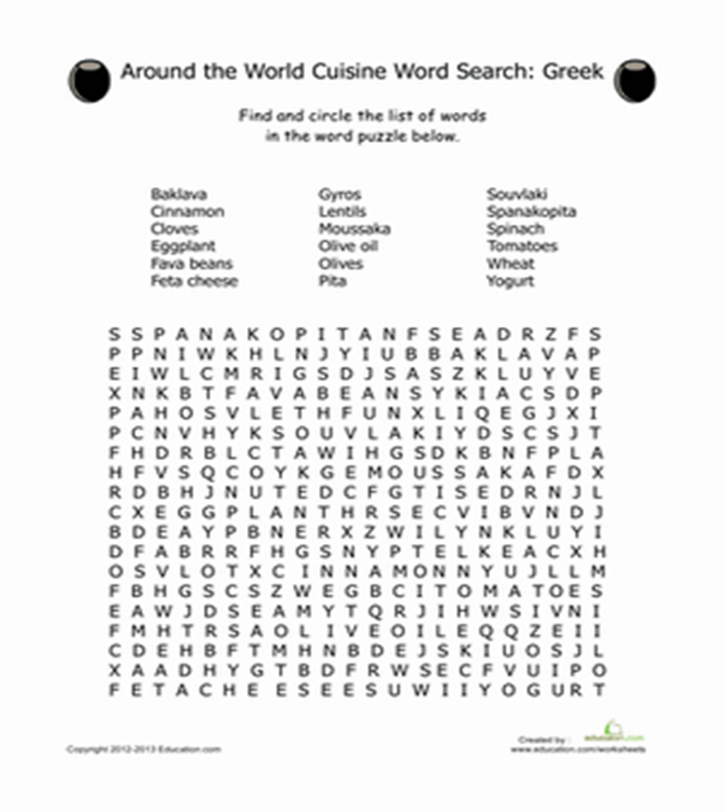

Slide 18
