Slide 1
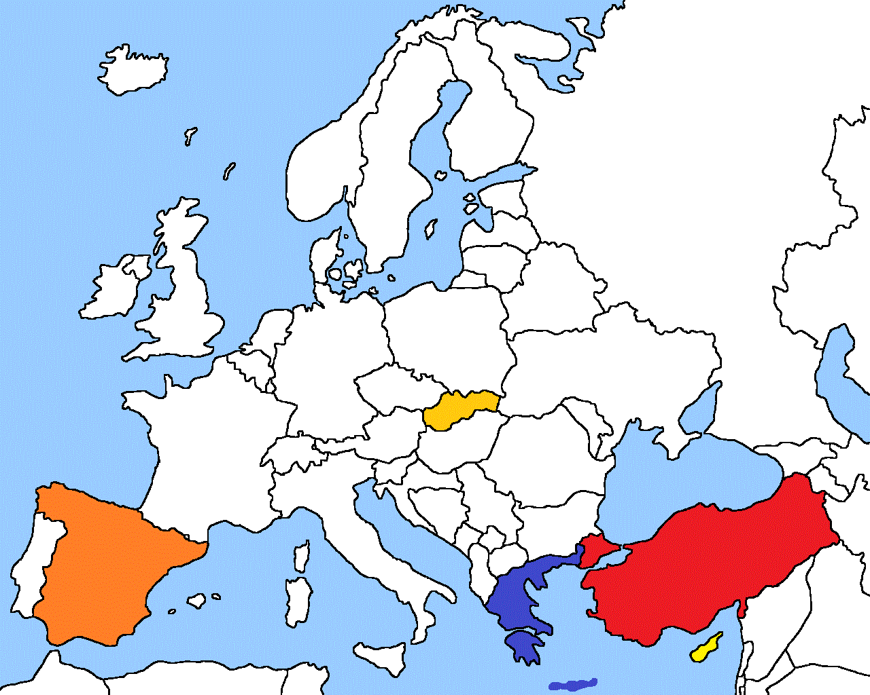
FOOD ETHOS COURSE Food Education in European Schools (FEEDS) ERASMUS⁺ SCHOOL PARTNERSHIP 2018-20
SLOVAKIA
Kosice
TURKEY
Kayseri
SPAIN-BASQUE COUNTRY
GREECE
Velestino & Aiani
GREECE
Velestino & Aiani
CYPRUS
Larnaca

Slide 2
Let’s remember….
MINUTES of the 1st Meeting in Kayseri TURKEY 25th – 30th November 2018
Cyprus presents their habits and school
the Basque logo has to be digitized (and all other partners’ logos, to be used in the website and alongside the project)
Send Logos to Apostolis and Maria
next meetings were agreed on as follows (arrivals & departures):
2nd: Aiani – Greece = 10th – 15 February 2018
3rd: Sopuerta – Basque country, Spain = 8th – 12th April 2019
Next year’s meetings were agreed on by month and will be finalized in Spain:
4th : Kosice – Slovakia (November)
5th : Larnaca – Cyprus (February)
6th: Velestino – Greece (April)
After each meeting, partners issue press release articles and send them to the Project website partner (Aiani or Velestino)

Slide 3
official common format for all documents shared and sent (Invitations, programs, certificates of Attendance –individual & Group, Minutes) with the project logo, so as soon as we have it, all documents will be according to one template
All possible questionnaires will be presented in Aiani
Project website : https://erasmusfeeds.weebly.com/
Check for updates and/or corrections
Send Aiani the articles (web links, or scans) as well as all material dealing with the project
Communication is towards the host and the coordinator prior to booking
objective : to use Nutrition in our curricula, so in-school subjects can incorporate this aspect.
Facebook wall profile: https://www.facebook.com/groups/286271788763298/?ref=bookmarks
if possible, invite those students of the project who are in Fb in the Project wall.

Slide 4
What has been done
What we are going to do
Website (Greece)
Logo (Spain)
Present habits questionnaire (Slovakia)
Fill in the questionnaire (all)
A parents’ questionnaire (Greece)
Feed the Website with statistics from questionnaire, info from meetings, press release / website: fb, instagram, RSS
Create templates
Past habits questionnaire (Spain & …..)
Fill in this questionnaire (all)
Study food and nutrition in subjects (history, geography, chemistry, P.E. etc)
Create Food & Body Anatomy Board (poster)
What extras can be done (and shared)
Students’ brainstorming on the Course
Parents’ questionnaire
Vegetable garden
Interview older people on traditional food
Explore various diets

Slide 5
What we are going to do – next steps
Past habits questionnaire (Spain & …..)
Fill in this questionnaire (all)
until april 8th
Study food and nutrition in subjects (history, geography, chemistry, P.E. etc ) – (all)
E.g.: Velestino students are working in teams on
Ancient Greek diet
Athletes’/sports diet
Mediterranean (& Cretan) diet
Monasterial / monk diet
Chocolate: stereotypes & pros
Food in chemistry and biology - qualities in vitamins, fibres, carbohydrates
until May

Slide 6
Start from the end outcome: Course
Simple topics
Pyramid of food
Past eating habits
Present eating habits
Statistics and data
Comparison of past and present
Teach and do
Cooking
Year-long
Duration of each lesson
Students brainstorming
Adapt material to each country
Bring in experts

