Slide 1
Foods that Heal Cyprus Erasmus Team
Food Ethos EDucation in Schools
4th Meeting in Kosice, Slovakia

Slide 2
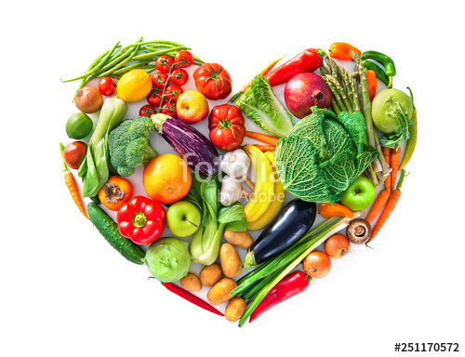
Proper nutrition leads to our natural health
Food should be our medicine and
our medicine should be our food
If our diet is not right, no doctor can cure us
When we eat properly,
we don't need a doctor

Slide 3
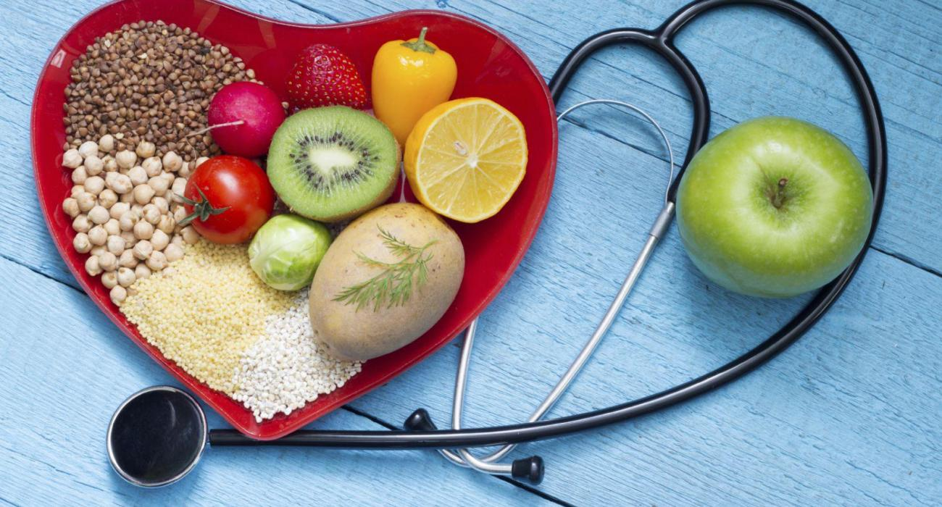
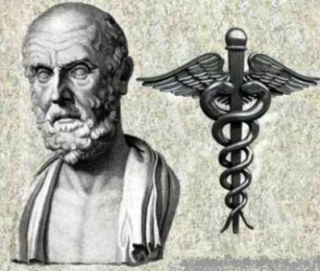
Hippocrates(ancient Greek doctor)
He believed that proper nutrition, exercise, rest, contact with nature and positive thinking are the best medicines for man.
He says :
«Nature heals as long as it is given the opportunity»

Slide 4
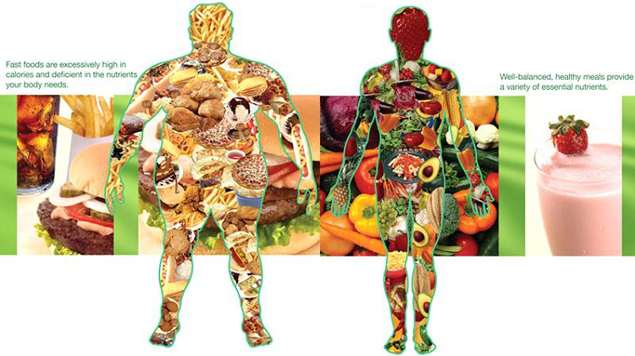
Foods heal the human body
Health and nutrition have been going on together for thousands of years.
Fruits and vegetables help us eliminate most of the body toxins, they cleanse the body, and help the bowel function.

Slide 5
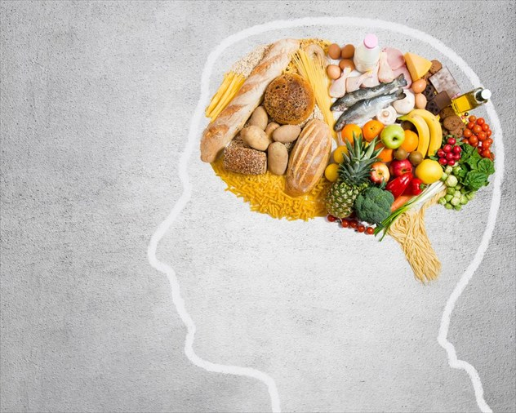
For physiological function of the Brain we should eat egg yolk, celery, garlic (gives brain vitality and energy)and onions.

Slide 6
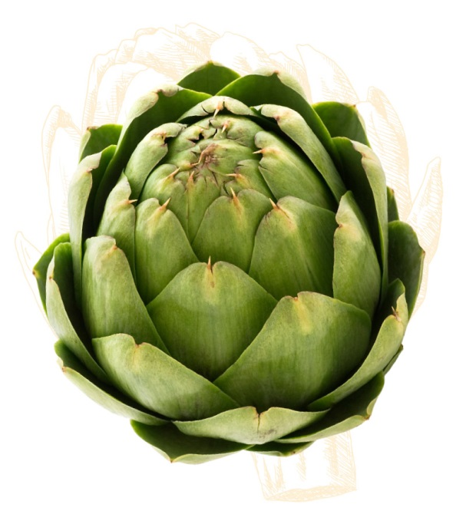
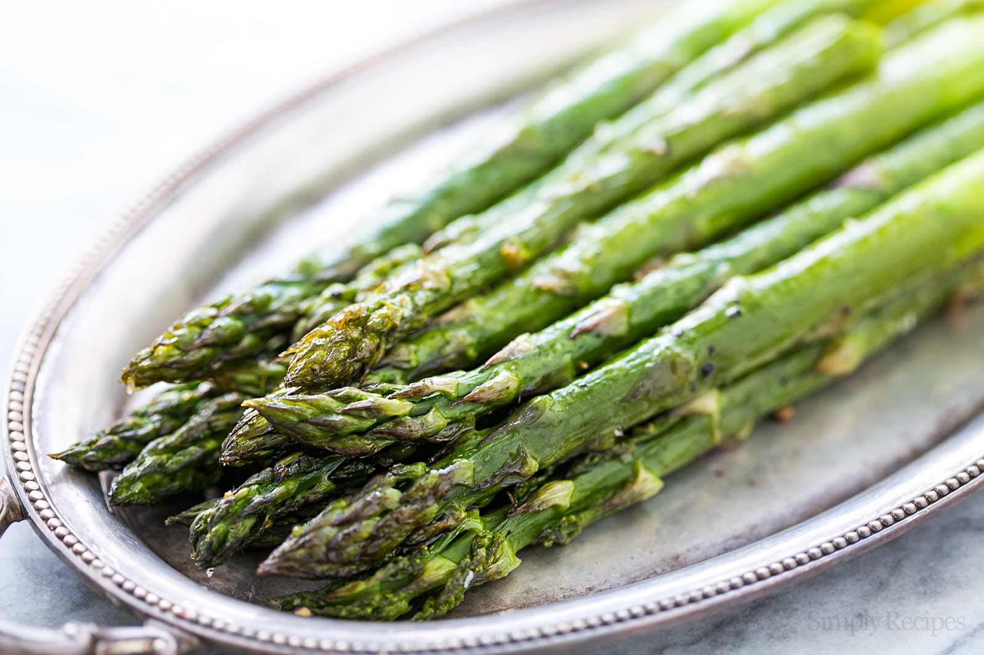
Artichokes: They help to fight infections, they contain vitamins A and C and are rich in calcium and iron.
Asparagus: They stimulate the kidneys, they have chlorophyll and are very good for the blood.

Slide 7
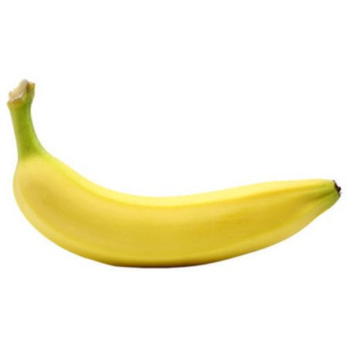
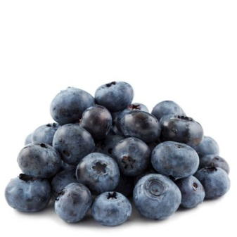
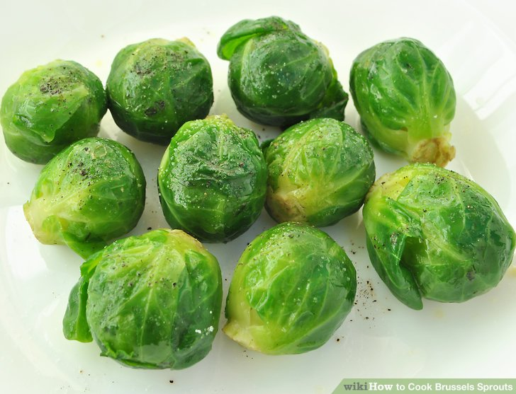
Banana: Helps the muscular system.
Blueberries: Good for the restructuring of the pancreas.
Brussels Sprouts: Good for the circulatory system, it’s ideal to keep us warm at winter.

Slide 8
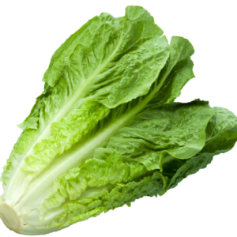
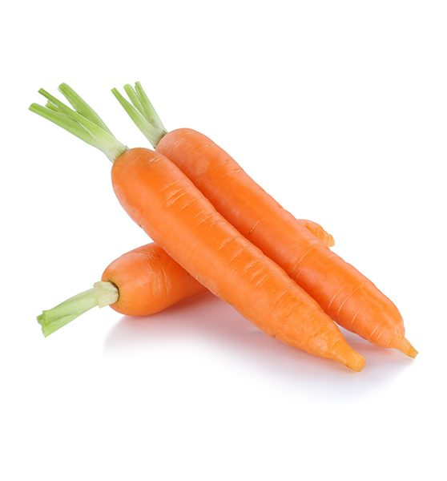
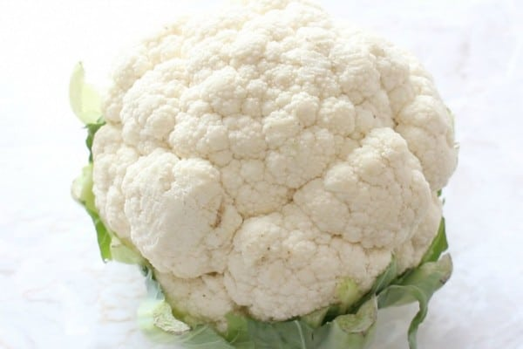
Lettuce: Helps fight problems with the blood and is ideal for fighting dermatological problems. Maintains the skin clean and healthy.
Carrot: Improves eyesight.
Cauliflower: Good for diabetic people.

Slide 9
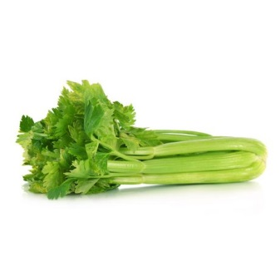
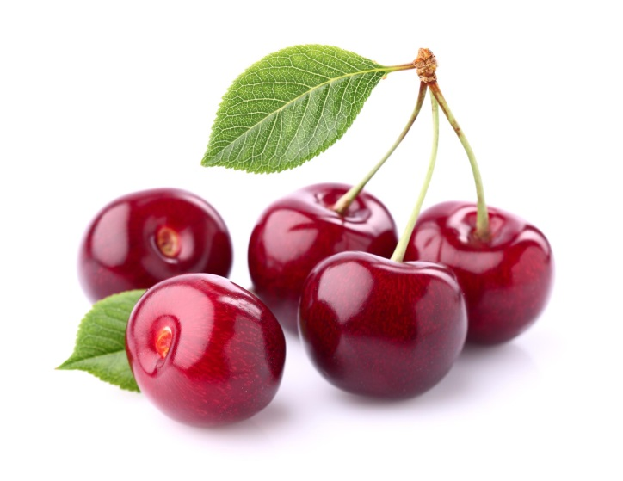
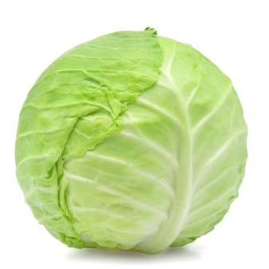
Celery: Preserves the well being of the body, keeps our muscles flexible and nimble.
Cherries: Important for enabling the endocrine system.
Cabbage: Good for the respiratory, digestive and urinary system.

Slide 10
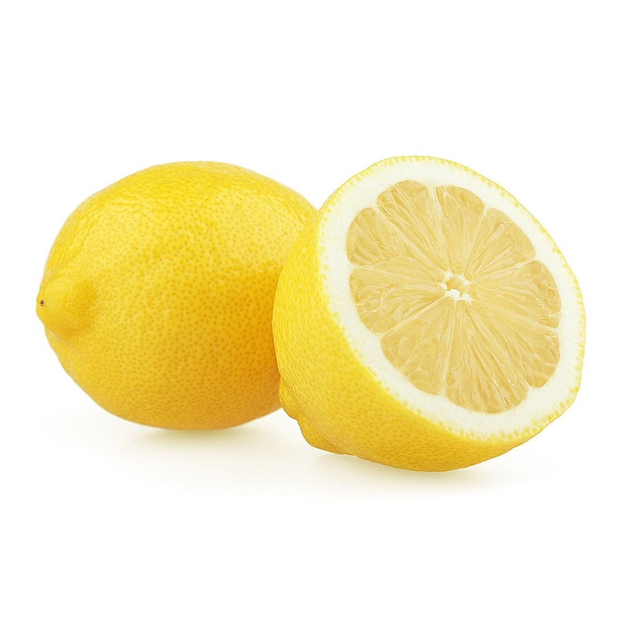
Lemon: Is ideal for the elimination of toxic substances from the body. Good for throat infections. With the first symptoms of a cold, you should drink a warm lemonade. The juice of lemons can help with fever.

Slide 11
Bibliography
Dr. Bernard Jensen Foods that heal.
Puplished by Costas A. Giannikos for modern times S.A. September 2008

Slide 12
Thank you!
Christina Mavrou
Andreas Victor Phasarias

