Slide 1
GEL VELESTINOU
Food recipes- the process

Slide 2
How we worked on recipes
We divided in teams
Each team chose a recipe
We cooked the recipes
We took photos
We tasted them!
One team chose to edit photos and do the presentation

Slide 3
Recipes - Teams
Tahinopitakia (rolls with tahini) – AXA
Choco rocks (chocolate with nuts) – Ka(i)menoi
Greek salad (in bowls, sandwich and spits) - Tiny
Eliopsomakia (olive buns)- Megaaz
Pasteli (sesame and honey bars)- Super4 and Ka(i)menoi

Slide 4
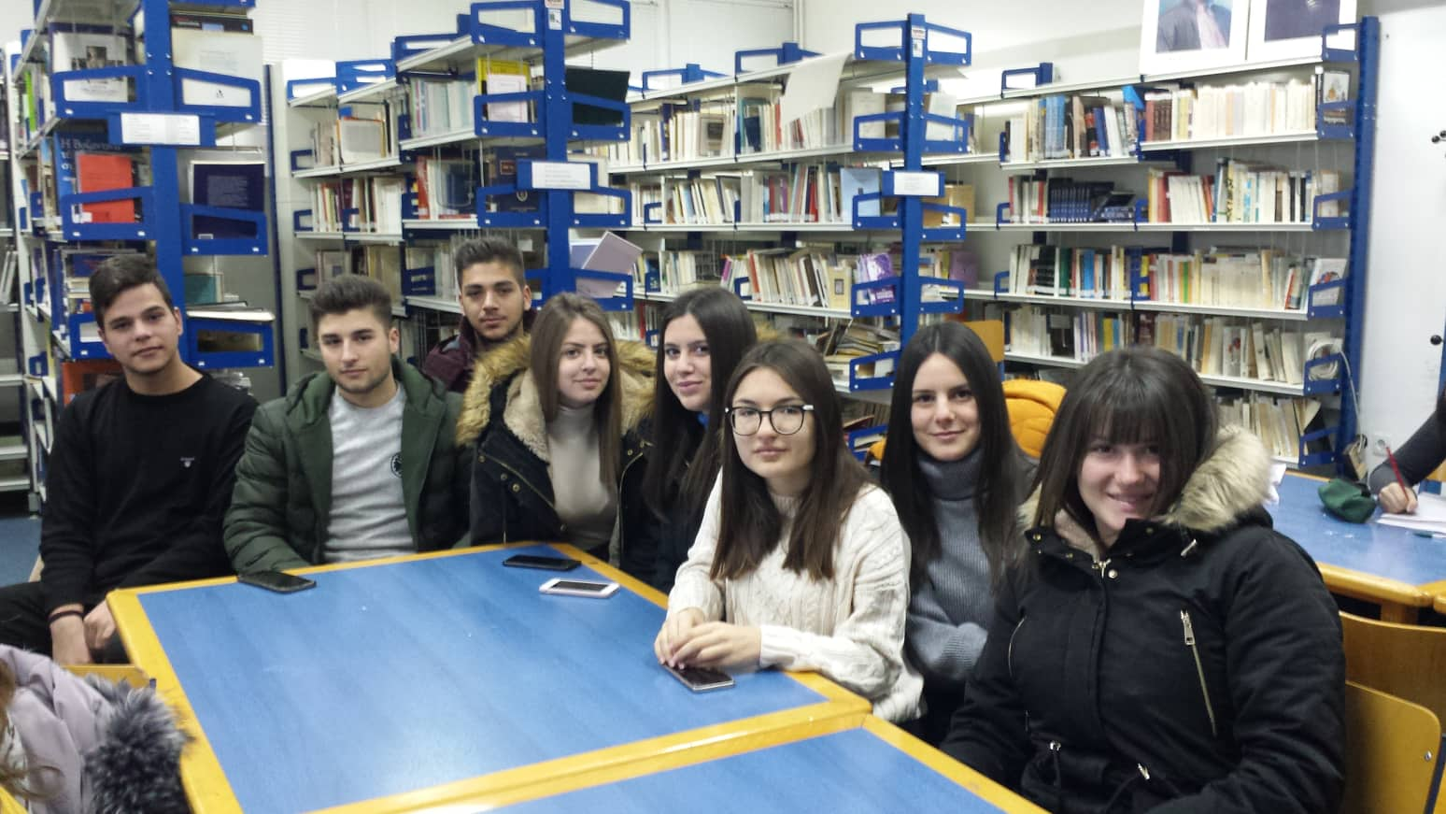
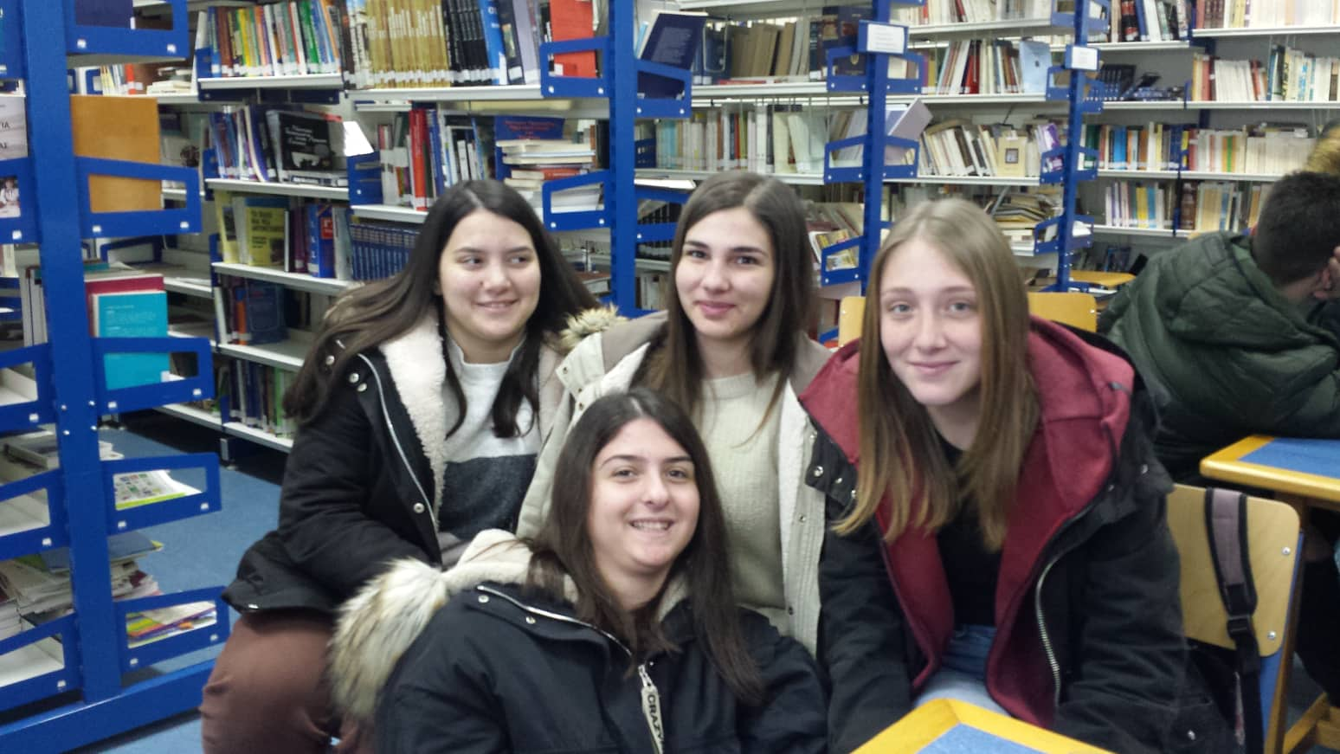
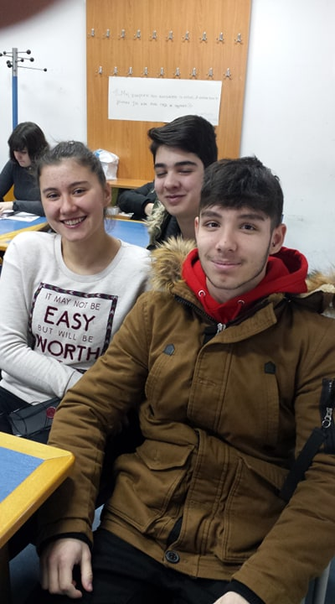
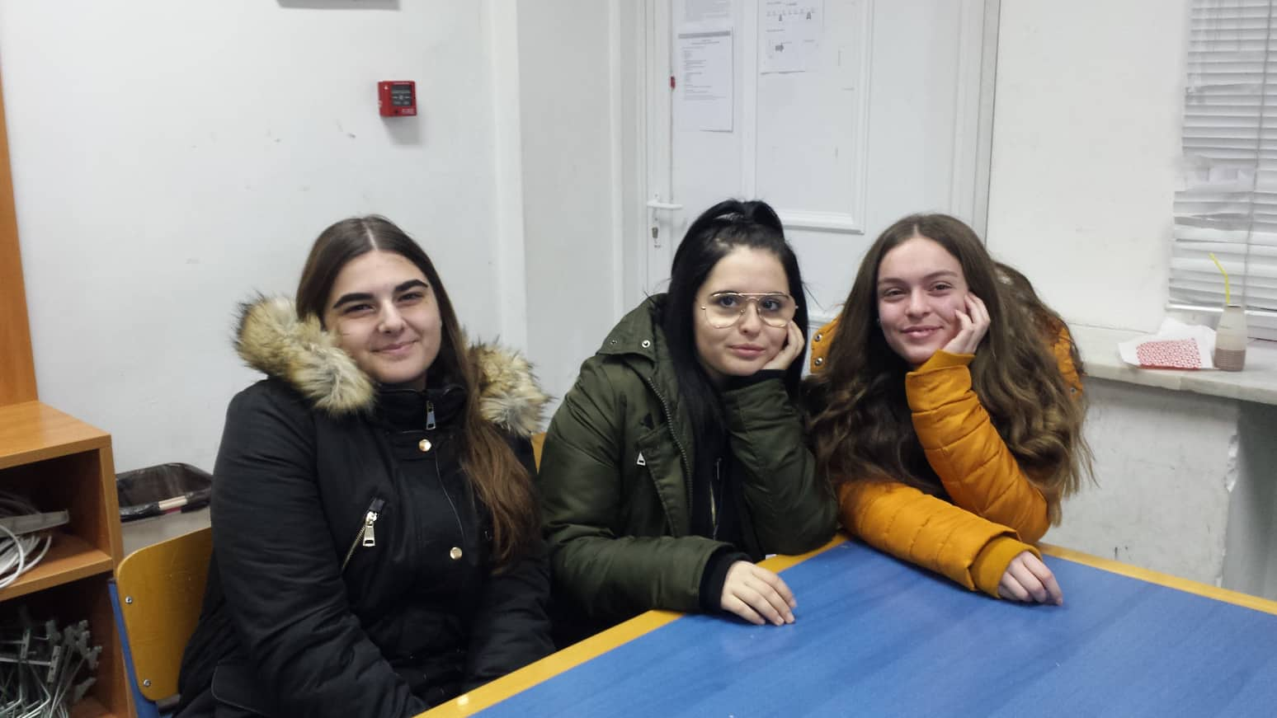
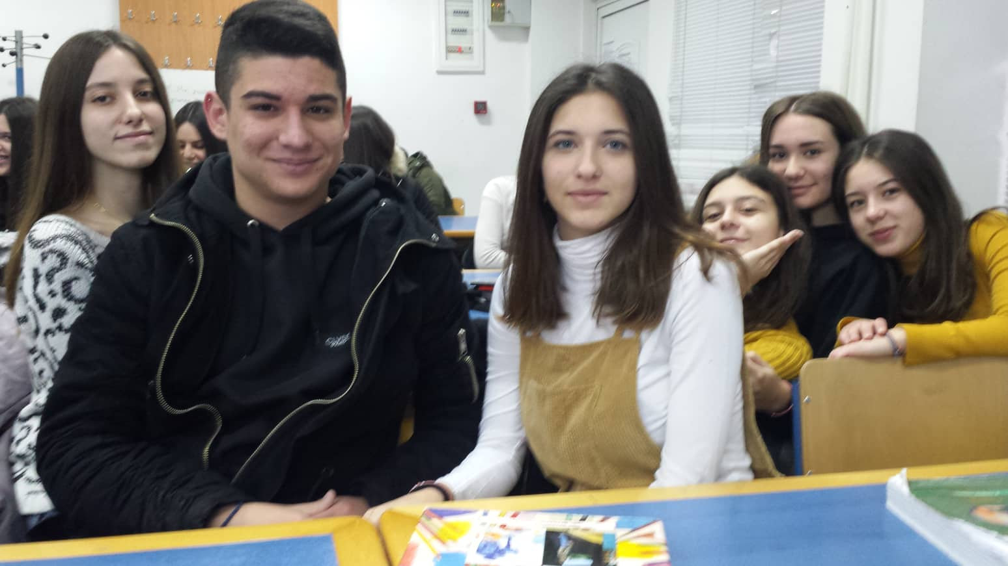
The teams

Slide 5
Ka(i)menoi
Vasso Sanida
Maria Agrokosta
Kerasia Dragoidi
Paolina Ntouro
Anastasia Nanopoulou
Sakis Kolokotronis
Panos Ntafos
George Athanasopoulos

Slide 6
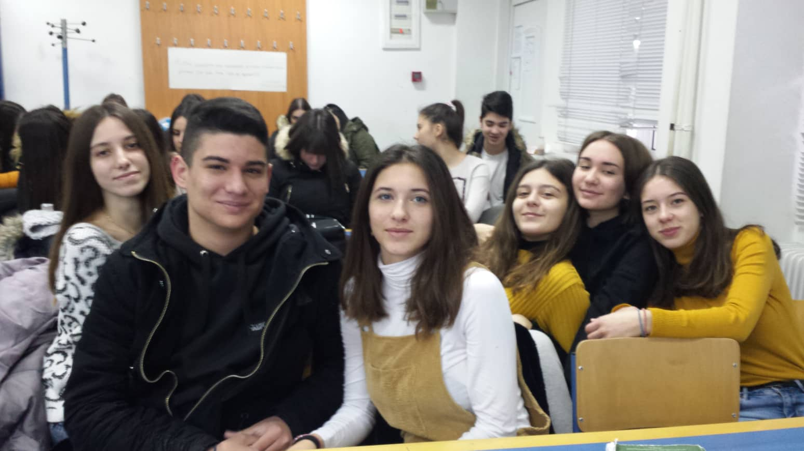
MEGAAZ
Apostolis Paipais
Evaggelia Savvanaki
Maria Gkoma
Antonia Ntontou
Georgia Giannakossian
Zoi-Mina Koumanidi

Slide 7
Super4
Maria Prassa
Chrisa Kiklou
Zeta Ntelopoulou
Zoi Peristeropoulou

Slide 8
AXA
Adamantia Diamantopoulou
Aggeliana Ntova
Christina Theohari

Slide 9
Tiny
Stella Bazouki
Ilias Spandonis
Nikos Chatzopoulos
Gogo Kouvela

Slide 10
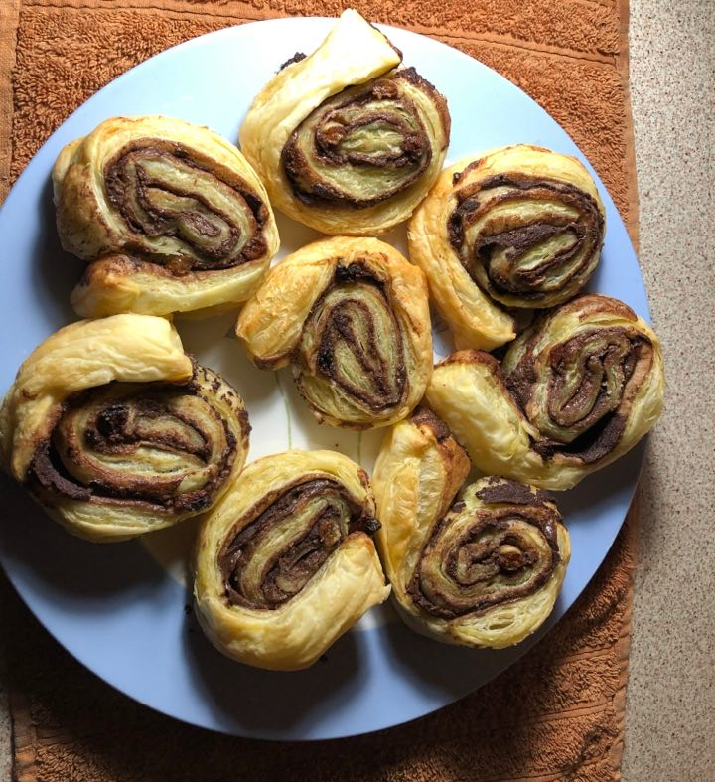
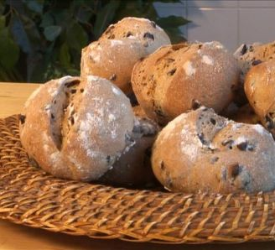
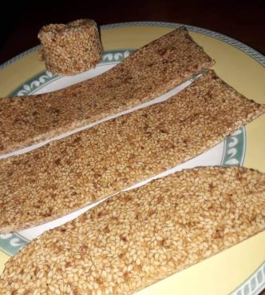
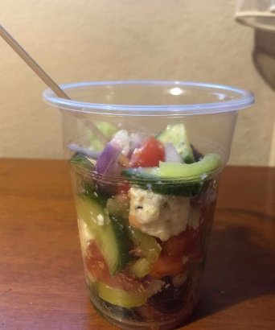
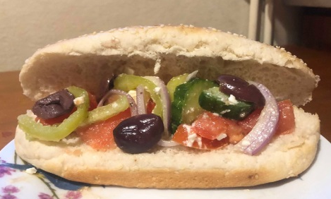
The recipes
Eliopsomakia (olive buns)
Pasteli (sesame and honey bars)
Tahinopitakia (rolls with tahini)
Choco rocks (chocolate with nuts)
Greek salad (in sandwich and bowls)

Slide 11
We all enjoyed this process!

