Slide 1
Erasmus+ 2018-2020 “Food Ethos EDucation in Schools”
Fifth Meetting
Vergina Gymnasium
Larnaca– Cyprus
10-14 February 2020

Slide 2
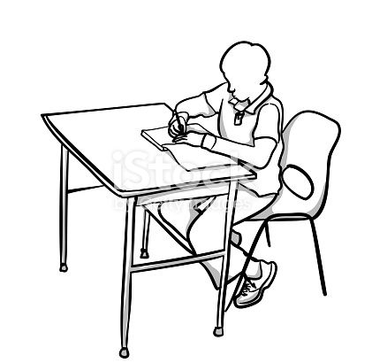
NUTRITION FOR EFFICIENT
READING

Slide 3
In addition to reading, which is undoubtedly the most important weapon for students nutrition plays a prominent role in maximizing performance. The nutrition of the reading child is important. Reading and learning are serious and complex functions. To succeed they need to be done the right way.

Slide 4
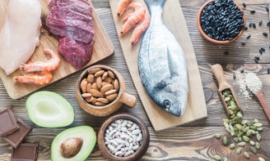
PROTEINS. They are found in meat, chicken, fish, egg, milk and pulses. They play a pivotal role in the majority of human functions so their absence would inevitably be disastrous for the body.

Slide 5
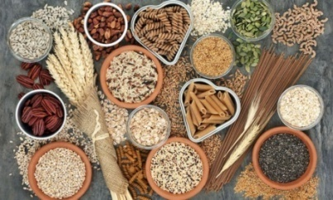
CARBONS. Foods such as bread, cereal, potatoes, pasta, fruit and sweets are the easiest source of energy for our body, while glucose, the simplest of carbohydrates, is the main fuel of our brain. During the night's sleep glucose levels in our body decrease and when we wake up they slowly increase. Low blood glucose has been associated with poor memory, difficulty in concentrating and learning. So by eating breakfast, we increase blood glucose levels and allow our body to function properly.

Slide 6
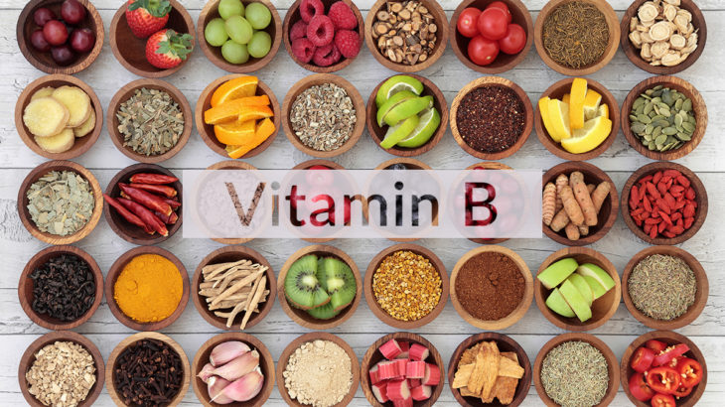
VITAMINS B. Thiamine, folic acid, vitamins B6, B12, choline. They are the queens of reading and you will find them in: nuts, whole grains and dairy products. They help memorize, have anti-stress properties, improve our mood and release energy from food.

Slide 7
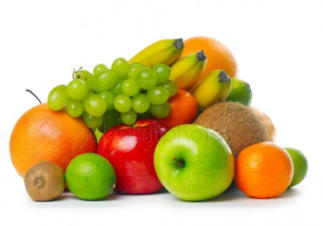
MAGNESIUM. You will find it in many foods such as seeds and green vegetables, legumes, bananas, rice, spinach. It is the most important messenger of the nervous system, so it helps reduce stress.

Slide 8
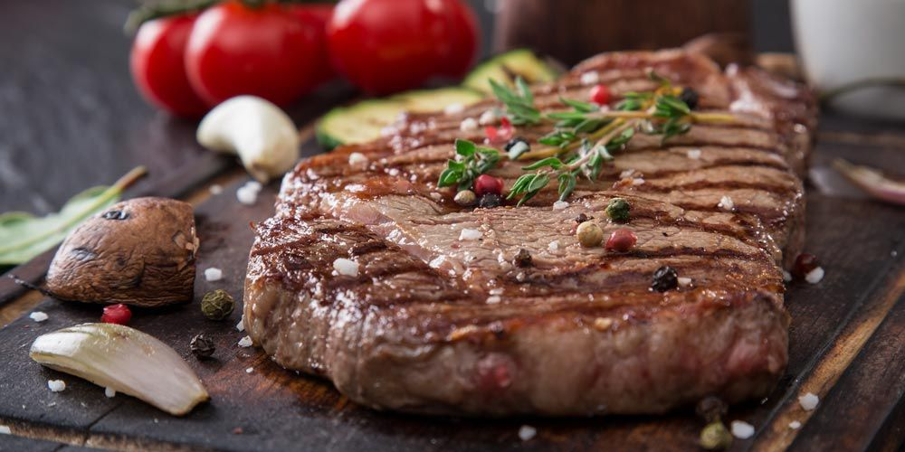
ZINC. The best source of zinc is red meat, as well as legumes. Lack of precious metal affects the ability to concentrate, while supplementing our diet with it increases pupils perception.

Slide 9
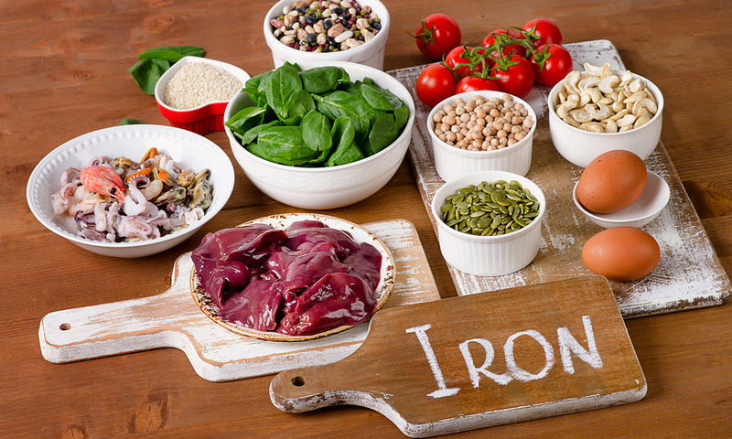
IRON. Available in liver, red meat, cereal, poultry, fish, pulses or dark green vegetables. It carries oxygen throughout the body and, of course, to the brain.

Slide 10
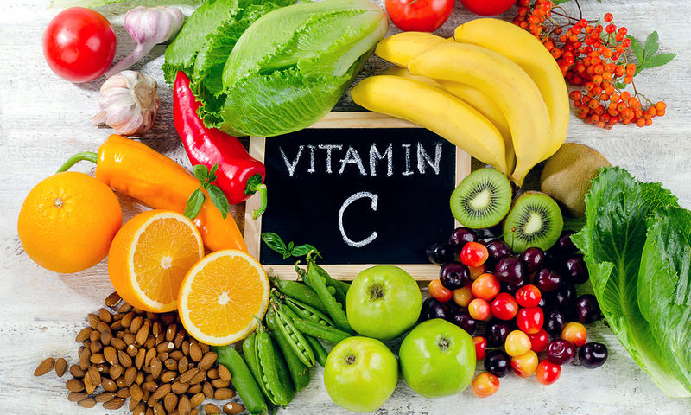
Vitamin C. It is found in fruit such as strawberries and kiwi, and is also found in peppers.

Slide 11
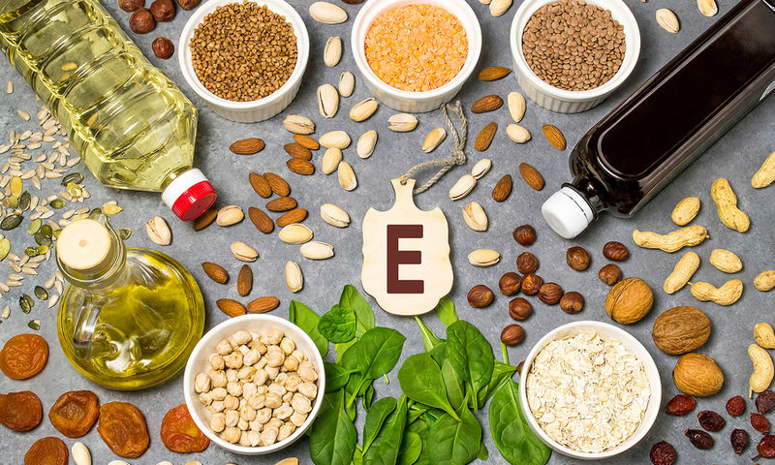
Vitamin E. It is found in foods such as nuts, asparagus, olives and whole grains.

Slide 12
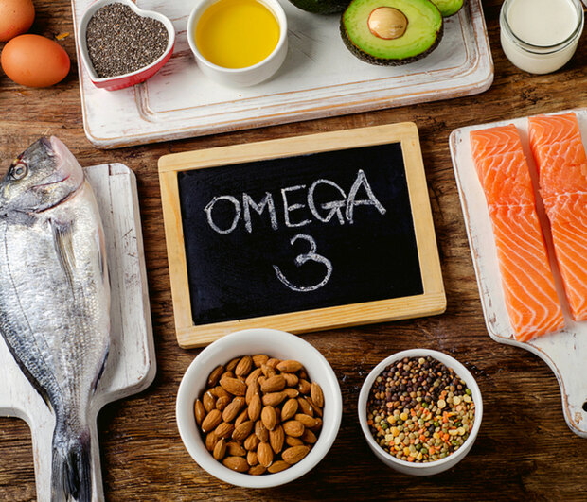
O-3 fatty acids. They are found in rat oil, nuts and fish. It is emphasized that both vitamin E and omega-3 fatty acids prevent and protect the brain from memory loss.

Slide 13
FATS. Contained in various oils, butter, meat fat and most sweets are the best form of stored energy.

Slide 14
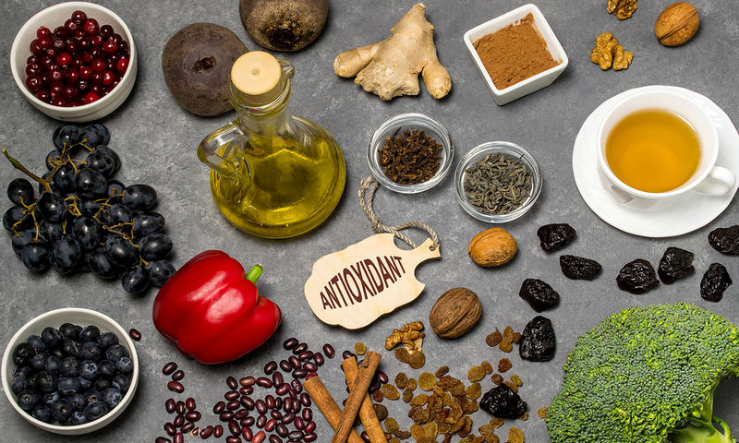
Antioxidants. They are found in fruits and vegetables. They should not be missing out on our daily diet.

Slide 15
WATER. Another factor that helps is proper and adequate hydration. The body is hydrated with water. However, it can also be achieved in alternative ways. We refer to drinks such as coffee, tea (especially green) and natural juice. Of course, fruit and vegetables whose water content reaches 80% cannot be omitted from our reference. Many times the causes of headaches are due to lack of proper hydration while consuming fluids after headaches can eliminate them. Proper hydration also reduces concentration problems and memory problems

Slide 16
GREEN TEA. It is a healthy choice rich in antioxidants. These substances protect the tissues of the body and contribute according to the above theory to the protection of the brain and the learning process.

Slide 17
CHOCOLATE. Contains cocoa which can improve verbal fluency and cognitive function. In addition, it improves blood flow to the brain as well as the psychological mood of the individual. Consuming it may be useful during reading periods due to the magnesium it contains, which helps memory. It is also a food that should be consumed in moderation because of its high calorie and fat content. We prefer dark chocolate that is rich in antioxidants.

Slide 18
Good sleep and a healthy diet will provide you with the prerequisites to endure and pay for the energy and effort required. Remember that reading and learning need energy and effort. Attention and concentration suffer when you are tired, lacking sleep or you are subject to factors that drive your thoughts elsewhere. The foods mentioned above help not only read but also maintain good health and we encourage you to include them in your diet. Finally, do not miss regular exercise.

Slide 19
Thank you very much for your attention

