Slide 1
ERASMUS+ Food Ethos Course
Diets and nutrition
GEL VELESTINOY

Slide 2
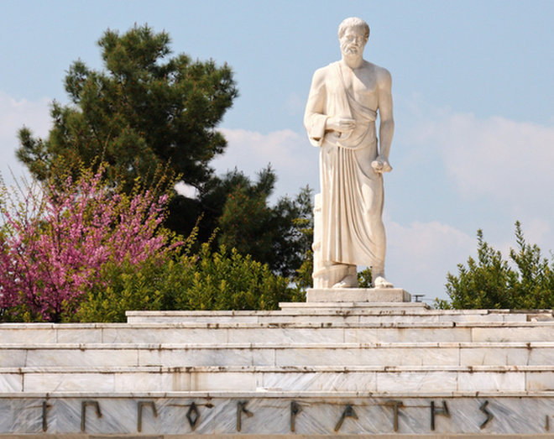
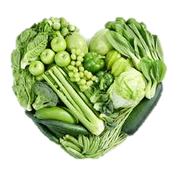
Hippocrates' diet
Hippocrates observed peoples’ personalities, home environment, relationships, diet, before diagnosing and treating them. He believed that it was impossible to understand illness without understanding the whole person.
Hippocrates said that “those who are naturally overweight are more possible to die quickly than those who are slim” and recognized that when people ate mainly a fresh, plant-based diet, they developed fewer diseases. His primary form of treatment was usually improving a patient’s diet.

Slide 3
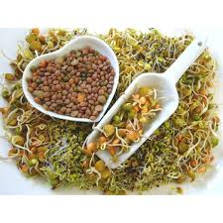
Hippocratic medicine was passive.
he was based on "the healing power of nature“
The body has the power to re-balance the four humours and heal itself (physis).
Hippocrates said: your food is your medicine, and to eat when you are sick, is to feed your sickness’’.
For example, only clean water or wine were ever used on wounds, and soothing balms from herbs.
he believed in Fasting
He used a mix of honey and vinegar for cleaning the body and for illnesses .

Slide 4
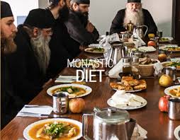
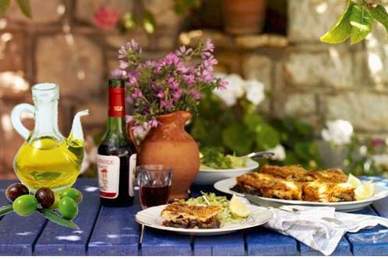
Monastic diet
The traditional diet of the monks in Greece is based on the The Cuisine of Mount Athos and is rich in vitamins (A, C, E), folic acid, antioxidants and fiber. On the contrary, it is “poor” in saturated animal fats. Legumes are the “meat” of fasting (rich in complex carbohydrates, vegetable proteins with low fat).
Bread is made of wheat flour of whole grain.
Their diet also includes fish, fresh fruit, honey, fasting sweets, and sweets with milk, butter and eggs. Their common sweet is halva with sesame and sugar.

Slide 5
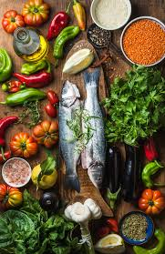
The benefits of the monastic diet:
Reduces cholesterol and triglyceride levels in the blood.
Regulate blood sugar and blood pressure.
Protects against osteoporosis and various types of cancer.
Anti-aging properties.
Promotes better bowel function.
Long life.
Good physical condition
Balanced psychosomatic condition, well-being

Slide 6
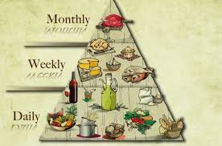
Mediterranean diet
A diet inspired by the eating habits of Greece, Southern Italy, and Spain in the 1940s and 1950s.
Basics: olive oil, legumes, whole cereals, fruits, and vegetables, fish, dairy products (mostly as cheese and yogurt), wine.
The Mediterranean diet lowers the risk of heart disease and early death, with olive oil lowering all-cause death and the risk of cancer, heart disease, and several chronic diseases.
It relies on the Pyramid of Food.
UNESCO included the Mediterranean diet of Italy, Spain, Portugal, Morocco, Greece, Cyprus, and Croatia to the Representative List of the World Intangible Cultural Heritage.
"The Mediterranean diet involves a set of skills, knowledge, rituals, symbols and traditions for crops, harvesting, fishing, animal husbandry, conservation, processing, cooking, and particularly the consumption of food."

Slide 7
Cretan diet
The Cretan diet is known today all over the world, according to a study of the Rockefeller Foundation, shortly after World War II.
Specialists studied population groups (from 40 to 60 years old) from two Greek regions: Crete and Corfu. And from six other countries: Yugoslavia, Italy, Holland, Finland, Japan and the United States. 30 years later all (or almost all) of the participants from the other groups had died. In Crete, more than half were still alive.
Cretan cuisine only began to be talked about seriously in the early 1990s.

Slide 8
Benefits
It offers great benefit to human health. It is associated with agricultural life.
the island’s local population were poor farmers, but they lived happily in a beautiful natural environment; they worked their fields, enjoyed the most delicious fruit, and one or two small glasses of wine with every meal.
The island’s people had to rely on their land for almost all of their food products, and their food was not plenty – yet they had everything. They were the healthiest of all the population groups in the study. Heart diseases were almost unknown as well as cancer.
Basics: Greens and vegetables, a lot of pulses and very little meat (only every Sunday and on major holidays).

Slide 9
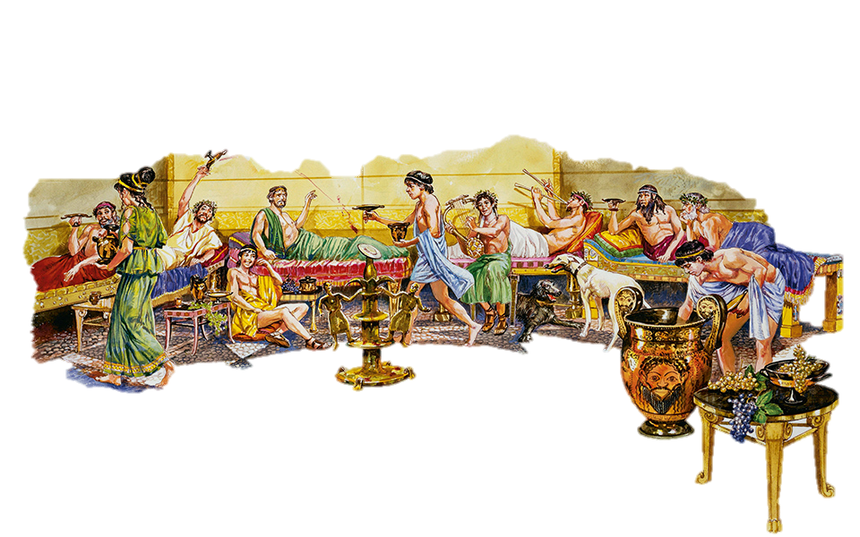
Ancient Greek diet
In ancient Greece people used to eat meat and seafood. They raised sheep, goats , pigs and cattle. The black pig of ancient Greece was transported to Spain as the same species and was the base for the “jamon iberico “ .
They hunted wild boars , deer , birds.
They ate mushrooms found in the forests and in particular the ancient “ydnon”, known today as truffle.
Herbs were the most important nature produce in ancient Greece. They were used not only as everyday food but also to cure various illnesses.
For breakfast they ate nuts, dried figs, almonds, walnuts, chestnuts, raisins.
There was no sugar. Honey was the traditional sweetener, as were figs, and products made from naturally sweet grapes. The honey bee was a sacred symbol of Artemis and an important design on Ephesian coins.
They used to drink wine with their meals mainly in banquets
Spartans used to drink the Black broil, to help them in battles.

Slide 10
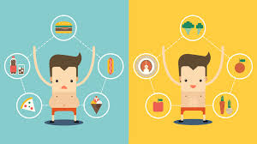
Athletes’ diet
an Athlete’s diet in ten points
• Don’t Run on Empty stomach
• Don’t Skip Breakfast
• Stay Hydrated
• Cut Out the Junk food
• Eat Iron-Rich Foods
• Make a Plan
• Don’t Restrict Yourself
• Don’t Count the Carbs
• Eat to Recover
• Eat Right

Slide 11
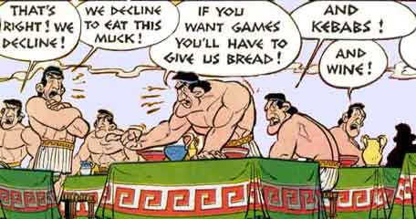
5 Nutrition suggestions for Athletes
1. Lots of Carbohydrates
Carbs are an athlete's main fuel. When you exercise, your body changes glycogen into energy.
2. Get Enough Protein, But Not Too Much
Prefer foods. Instead of protein supplements, eat lean meats, fish, poultry, nuts, beans, eggs, or milk.
Drink milk
3. Go Easy on Fat
For marathons, your body burns fat for energy.
Most athletes get all the fat they need by unsaturated fat from nuts, avocados, olives, vegetable oils, and fatty fish like salmon and tuna.
4. Drink Fluids Early and Often
5. Replace Lost Electrolytes

Slide 12
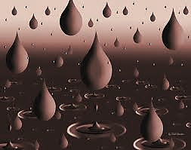
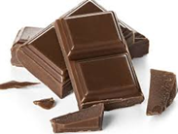
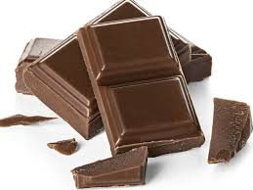
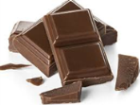
chocolate
Myths :
1. Chocolate increases bad cholesterol :
NO! in fact for some people, chocolate can lower cholesterol levels.
2. Chocolate is high in caffeine:
NO! A Hershey’s chocolate bar contains 9 milligrams of caffeine and a Starbuck’s grande coffee 320 milligrams.
3. Chocolate makes you gain weight:
NO! a small amount of chocolate each of five days during a week does not make you fatter, even if you eat more calories overall and don't exercise more than others. Hello, chocolate diet.
4.Eating sugar and chocolate can add to stress
NO! A study found that eating some dark chocolate a day for two weeks reduced levels of stress hormones.
5.Chocolate causes acne:
Studies show that “diet plays no role in acne treatment in most patients … even large amounts of chocolate do not cause acne.”

Slide 13
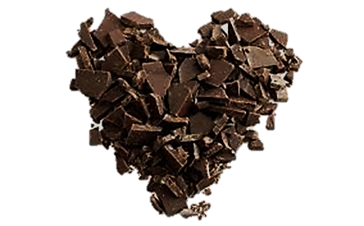
Benefits
lowering cholesterol levels
preventing Altzheimer
reducing the risk of heart problems
Improve Blood Pressure
It's good for your skin
It can help you lose weight
It's good for mothers and babies
It may prevent diabetes
Chocolate is good for the brain
Chocolate makes you feel better
Chocolate is … Heavenly delicious!!!!

Slide 14
Thank you!

