Slide 1

Cantine Recipes from Cyprus
ERASMUS 2018-2020

Slide 2
E - Book
The topic of the 5th meeting is the creation of an e recipe book.
So we wrote recipes for the 4 chapters of the recipe book which are :
Chapter 1: Cantine healthy recipes- school lunches
Chapter 2: Nowadys recipes
Captar 3: Tratitional recipes
Chapter 4 : Chocolate

Slide 3
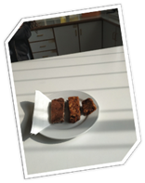

Fruits, Oats, Nuts and Chocolate Bars
Preparation time: 20 min
Difficulty: 1
Ingredients:
250 gr soft and dry dates
1 ½ cup oatflakes in powder
3 tbsp. honey (lukewarm)
2 tbsp. whole wheat tahini
1 cup raw or roasted nuts cut in big pieces
100 gr. Dark Chocolate finely cut

Slide 4
Fruits, Oats, Nuts and Chocolate Bars
Preparation:
Melt dates in a blender
Put dates in a ball and add the honey, the oats , the tahini and the nuts .
Stir to become homogenous
Finally add the chocolate pieces and stir
Put in a square tray. Press to become even.
Cool for 30 min.
Cut in oblong pieces.
Keep the bars in an airtight glass bottle
Makes 9 bars.

Slide 5
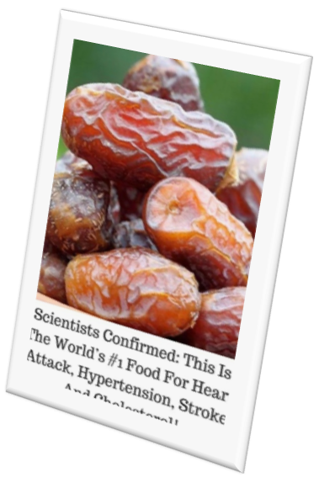
Dates
Dates are the fruit of the date palm tree,.
Dates are chewy with a sweet flavor.
Dates contain several minerals, including phosphorus, potassium, calcium and magnesium.
All of these have been studied for their potential to prevent bone-related conditions like osteoporosis.
Dates have the potential to help with blood sugar regulation due to their low glycemic index, fiber and antioxidants. Thus, eating them may benefit diabetes management

Slide 6

Health benefits of Dates
They are
1. Very nutritious
2. Rich in fiber
3. High in antioxidants
4. May Promote brain Health
5. Excellent natural sweetener
6. They may promote natural labor
https://www.healthline.com/nutrition/benefits-of-dates

Slide 7
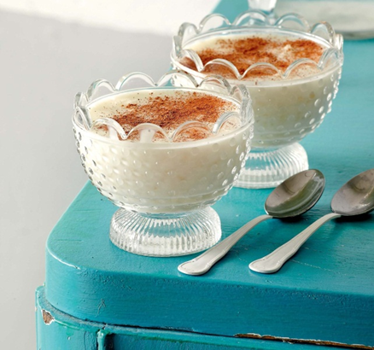
Rice Pudding
Preparation time: 30 min
Difficulty: 2
Ingredients:
4 cups Milk 1,5% fat
1 ½ cups water
1 cup brown rise washed
½ cup sugar
4 tablespoons honey
1 tablespoons corn flour
4 tablespoons flower water
.

Slide 8
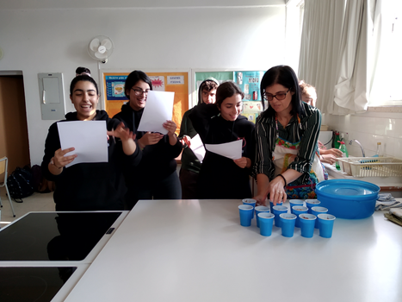
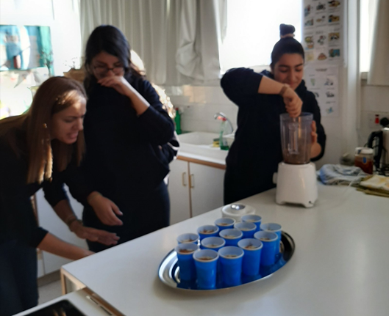
Rice Pudding
Preparation:
In a large saucepan boil the water. Wash the rise and add it to the water.
Pour in the milk, the sugar and the honey.
When it boils reduce the heat to low.
Stirring occasionally, cook for 20 to 30 minutes until it absorbs the milk.
Once thickened, add the flower water.
Remove from the heat.
Pour in small balls.
Let cool and then refrigerate.
Sprinkle with cinnamon.
Makes 5 balls.

Slide 9
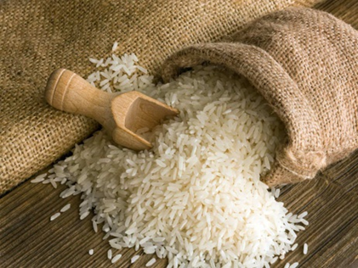
Rice
One of the oldest cereal grains, rice (Oryza sativa) is believed to have been grown for at least 5000 years.
It is a staple food for more than half of the world's population, particularly those living in southern and eastern Asia.
White rice is the most commonly consumed type, but brown (whole grain) rice is becoming increasingly popular in some Western countries due to its health benefits.
Various products are made from rice. These include rice flour, rice syrup, rice bran oil, and rice milk.
It is usually white in color, but brown rice can come in a variety of shades; brown, reddish, purplish, or black.

Slide 10

Health benefits of Rice
Brown rice is a food often associated with healthy eating. It retains the nutrients that white rice lacks such as vitamins, minerals, and antioxidants.
Brown rice contains more fiber than refined grains like white rice. Choosing fiber-rich whole grains like brown rice may reduce belly fat and help you lose weight.
https://www.healthline.com/nutrition/is-brown-rice-good-for-you
.

Slide 11
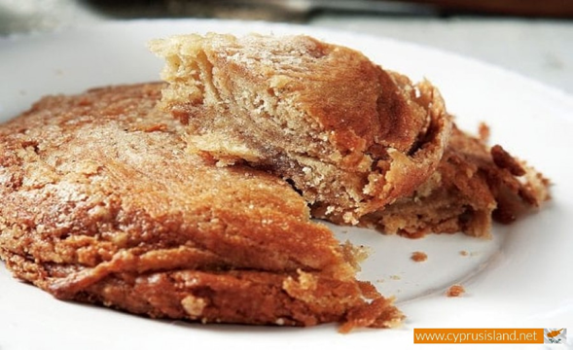
Small Tahini pies
Preparation time: 30 min plus one hour to rise
Difficulty: 4
Ingredients:
250 gr village flour
1 tablespoon olive oil
1 pinch of salt
1 sachet dry yeast
2 tablespoons sugar
140 gr water lukewarm
Filling:
200gr tahini
110gr sugar
1 tablespoon cinnamon
Syrup:(lukewarm)
200grwater
160grsugar
1 tablespoon cinnamon
Boil for 3 min

Slide 12

Mix yeast, sugar and water medium hot
Put the salt in the flour, add oil and mix
Add the yeast mixture and mix well.
Cover with membrane and a towel and let it rise for one hour
Make a large rectangular piece.
Put the filling on top
Roll and cut every 5 cm. Press to make the flat.
Cooking Time:
Bake 180º in preheated oven for 30 minutes.
Put the warm pies in lukewarm syrup.
Makes 20 round balls pies.
Preparation:

Slide 13
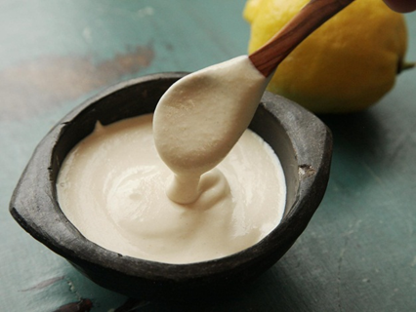
Tahini
Tahini is a paste made from toasted, ground sesame seeds. It has a light, nutty flavor.
It’s best known as an ingredient in hummus but widely used in many dishes around the world, particularly in Mediterranean and Asian cuisine.

Slide 14
Health benefits of tahini
1. It is Highly nutritious
2. Rich in antioxidants
3. May decrease your risk of diabetes and heart disease
4. May have antibacterial properties
5. It contains anti-inflammatory compounds
6. May strengthen your central nervous system
7. May offer anticancer effects
8. Helps protect liver and kidney function
9.Easy to add to your diet
(https://www.healthline.com/nutrition/tahini-benefits)

Slide 15
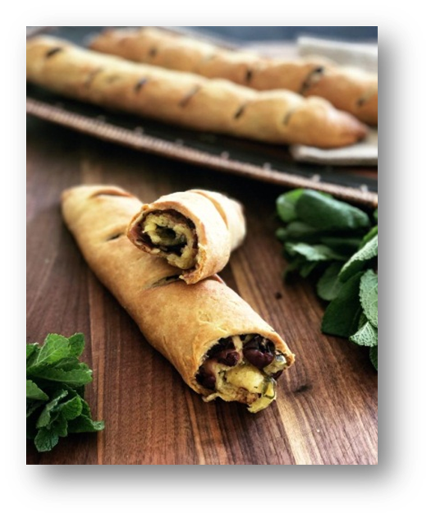
Eliopittes
Cyprus traditional olive pies
Preparation time: 30 min
Difficulty: 2
Ingredients:
4 cups village flour
1 cup olive oil
1 cup fresh orange juice
1 teaspoon Baking Powder
2 cups black Cyprus olives cut in big chunks
1 onion finely chopped
½ fresh mint finely chopped
1 cup fresh coliander finely chopped
½ cup sesame seeds

Slide 16
Preparation:
Mix olives, colliander, mint and onions in one ball
In another ball mix well the flour, BP and olive oil
Pour in the orange juice and knead
Add the olive mixture and half the sesame seeds and mix
Make round balls and sprinkle with the remaining sesame
Bake 180º in preheated oven for 35-40 minutes.
Makes 8 round olive pies.

Slide 17
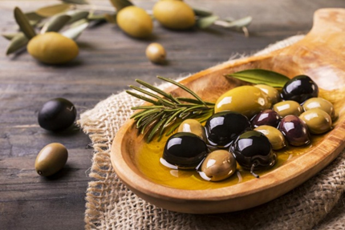
Olives
Olives are small fruits that grow on olive trees (Olea europaea).
They belong to a group of fruit called drupes, or stone fruits, and are related to mangoes, cherries, peaches, almonds, and pistachios.
Olives are often enjoyed in salads, sandwiches, and pies. The average olive weighs about 3–5 grams.
Some immature olives are green and turn black when they ripen. Others remain green even when fully ripe.
In the Mediterranean region, 90% of olives are used to make olive oil

Slide 18

Health benefits of olives
Olives are very high in vitamin E, iron , calcium, copper, and sodium as well as other powerful antioxidants such as oleuropein, hydroxytyrosol, tyrosol, oleanolic acid, and quercetin. Studies show that they are good for the heart and may protect against osteoporosis and cancer.
Also they prevent liver damage, regulate blood fats, reduce inflammation and lower blood pressure.
The healthy fats in olives are extracted to produce olive oil, one of the key components of the incredibly healthy Mediterranean diet.
(https://www.healthline.com/nutrition/foods/olives)

Slide 19
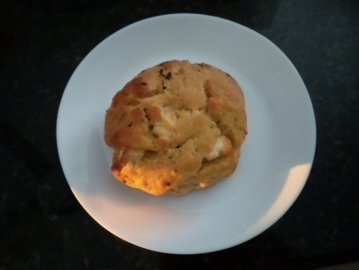
Halloumi Pie
Cyprus traditional Pie
Preparation time: 20 min plus one hour to rise
Difficulty: 3
Ingredients:
1 Kilo village flour
1 cup olive oil
1 pinch of salt
2 cups fresh orange juice lukewarm
2 sachets dry yeast
1 teaspoon sugar
2 village halloumi from goat and sheep cut in one cm cubes
¼ fresh mint finely chopped

Slide 20
Preparation:
Mix yeast, sugar and orange juice medium hot
Put the salt in the flour, add oil and mix
Add the yeast mixture and mix well.
Cover with membrane and a towel and let it rise for one hour
Finally add the halloumi pieces and the mint
Cooking Time:
Bake 180º for 45-50 minutes
Makes 20 round balls pies

Slide 21
History of Haloumi Cheese
Cyprus most famous cheese - Halloumi - is a delicious and versatile product that has a distinctive texture and is fantastic both cold and cooked (grilled or fried).
This white, semi-hard cheese has been produced on the island for centuries and is traditionally prepared with a precise quantity of goat or sheep’s milk in order to qualify as authentic Halloumi.
It can also be made with cow’s milk, or even a mixture of all three milks. Mint is often added to this salty cheese, and it has a long shelf life. https://www.visitcyprus.com

Slide 22
Health benefits of goat milk
1. It’s easier to digest
2. It’s good for the skin
3. It’s high in calcium and other minerals
4. It has healing properties
5. It contains fewer allergens
6. It’s good for your cholesterol
(http://home.bt.com)

Slide 23
E - Book
All the recipes will be included in the e- Book we made.

