Slide 1
The health benefits of chocolate
Andreas Phasarias
C1

Slide 2
Chocolate is rich in good fats, acids and vitamin E which protect your organism
The average consumption of chocolate 50-70 grams per week in a balanced diet and healthy lifestyle offers pleasure as well as countless of health benefits

Slide 3
Some say that there is a connection between chocolate and acne
However there is no research that shows proof for this statement. Although acne is connected to hormonal disorders

Slide 4
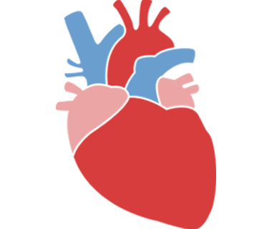
Chocolate stimulates the heart and the muscles, improves the blood flow of organs, helps the oxygen flow and makes us feel calm and peaceful
Other than the pleasure it gives us it can also drastically help us mentally making us feel happier and can fight depression

Slide 5
Chocolate is also rich in potassium, magnesium, calcium, vitamin A and amino acids. It can help against hypertension and it’s also good for our skin and hair
It is extremely important since it contains iron which is necessary for the production of hemoglobin

Slide 6
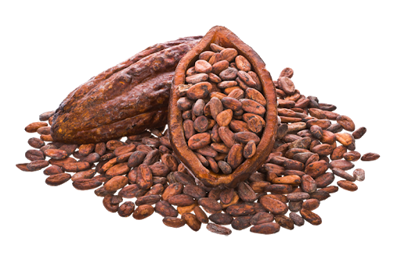
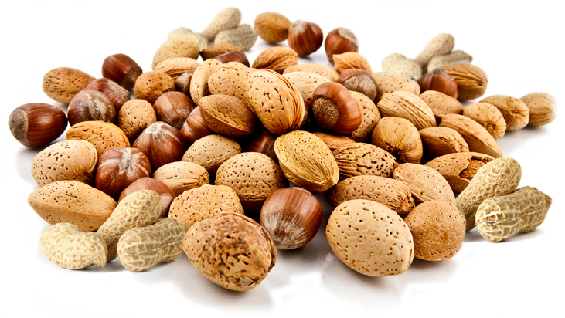
The cocoa that chocolate has contains antioxidants which help the blood flow, controls the level of cholesterol, helps fight against hypertension and different types of cancer
The pros of chocolate multiply when combined with nuts, like almonds which are rich in calcium, fiber, vitamins B and E, magnesium, copper, zinc, potassium and iron. In this way chocolate can prove to be one of the tastiest snacks as long as you are careful on how much you consume 50-70 grams per week

Slide 7
Dark Chocolate
A little bit of dark chocolate is a good choice in the end of an exhausting day. The consumption of dark chocolate helps in the reduction of stress and in the improvement of your attitude
Also its consumption can lead to emotions of excitement, vigilance and improves your positive attitude. Even more so it can help relax physically and mentally your body

Slide 8
Dark chocolate has less sugar and more magnesium and potassium than normal milk chocolate. Chocolate and cocoa play a very important role in the reduction of the danger of cancer. They reduce arterial pressure and improve vascular function

