Slide 1
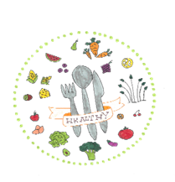
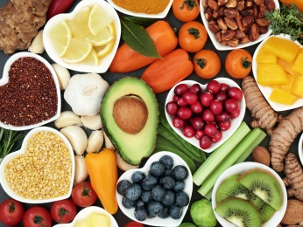
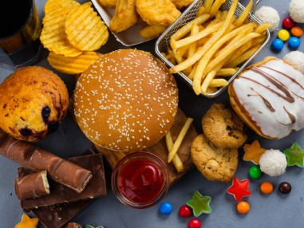
You are what you eat!
Food Ethos EDucation in Schools
4th Meeting in Kosice, Slovakia
Maria Laou
Cyprus Erasmus Team

Slide 2
Body anatomy!

Slide 3
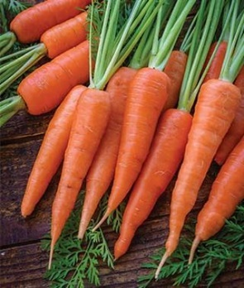
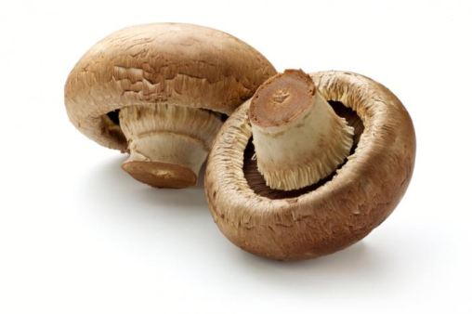
FOODS THAT RESEMBLE ORGANS THEY ARE GOOD FOR
1.Carrots improve your vision.
2.Mushrooms help to listen better.

Slide 4
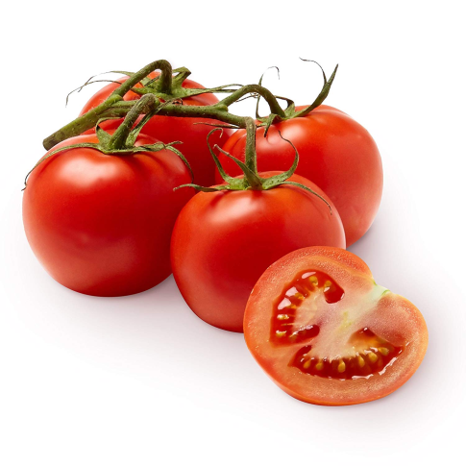
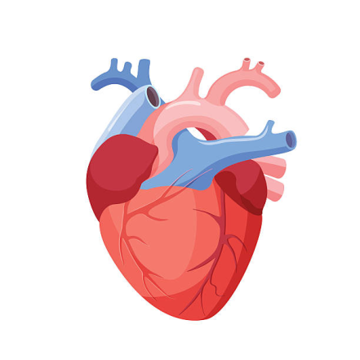
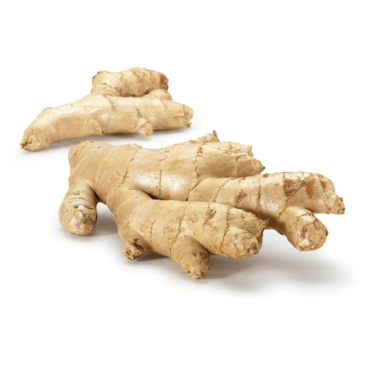
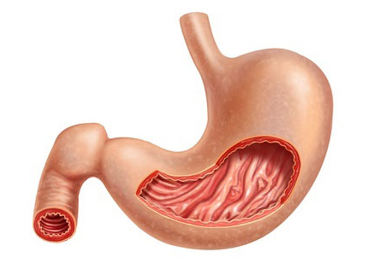
Food That Resemble Organs They Are Good For
4
3.Tomatoes reduce the risk of heart disease.
4. Ginger helps the stomach in many different ways…

Slide 5
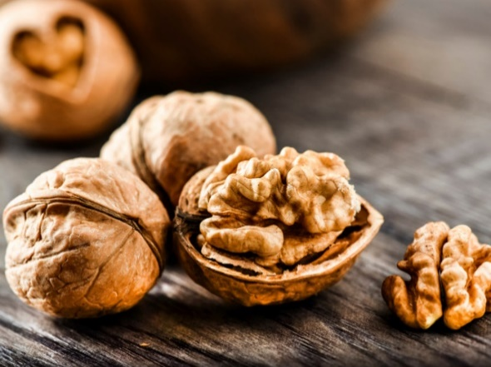
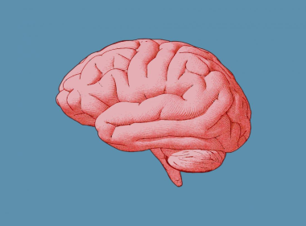
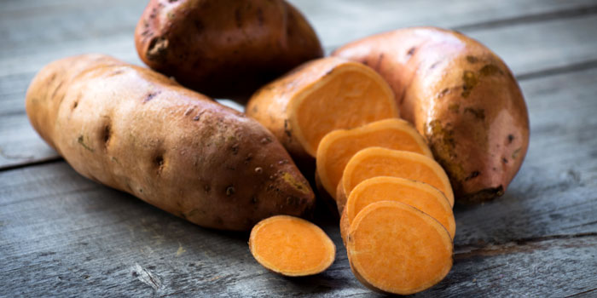
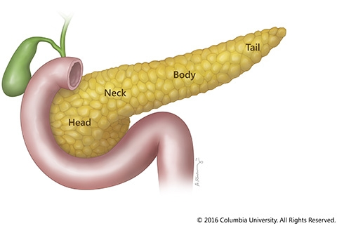
Food That Resemble Organs They Are Good For
It was recently found that eating nuts is strongly correlated with longevity. Nuts are also good for the brain.
5.
6. The sweet potatoes help the pancreas in many ways.

Slide 6
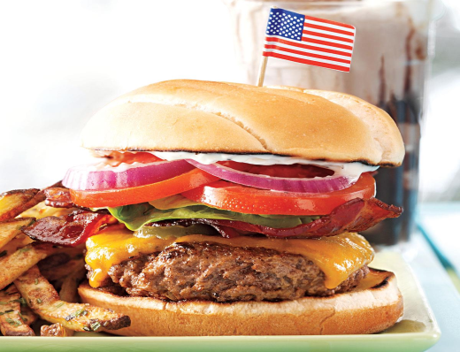
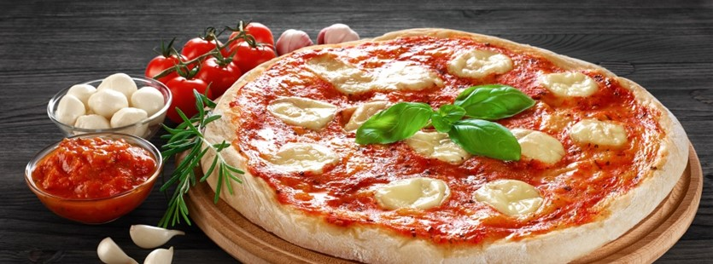
Countries and food !!
USA
ITALY

Slide 7
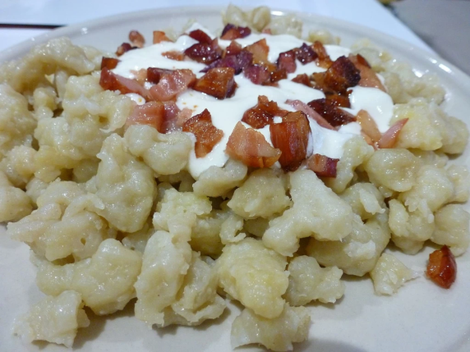
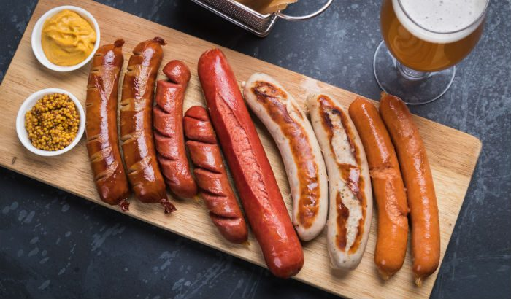
Countries and food !!
Slovakia
Germany

Slide 8
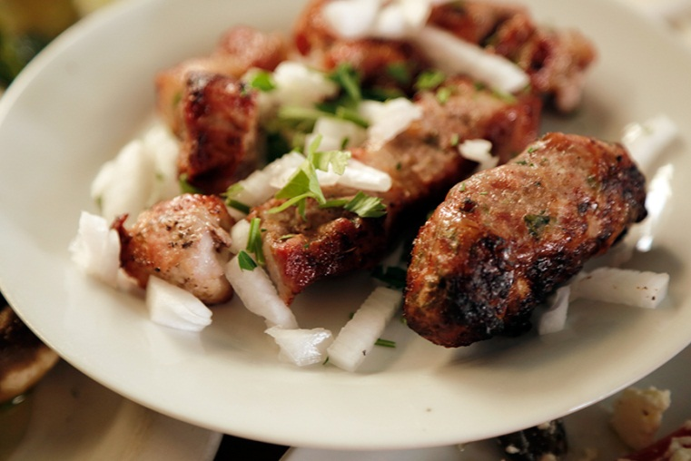
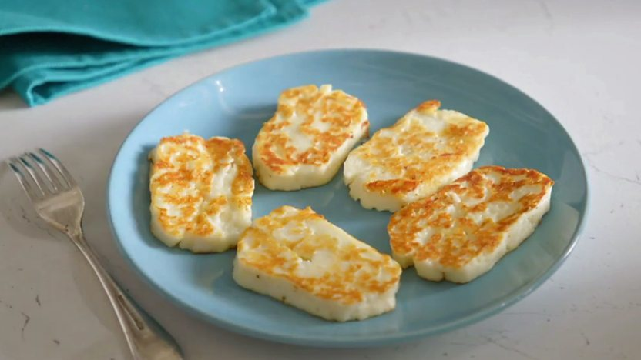
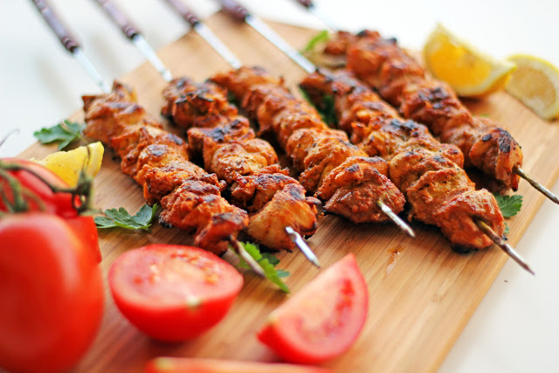
Cypriot food!!
Σιεφταλιές Seftalies
Χαλλούμι Haloumi Cheece
Σουβλάκια Souvlakia

